Slide 1
JENKINS PIPELINE
USING MAVEN JAVA PROJECT

Slide 2
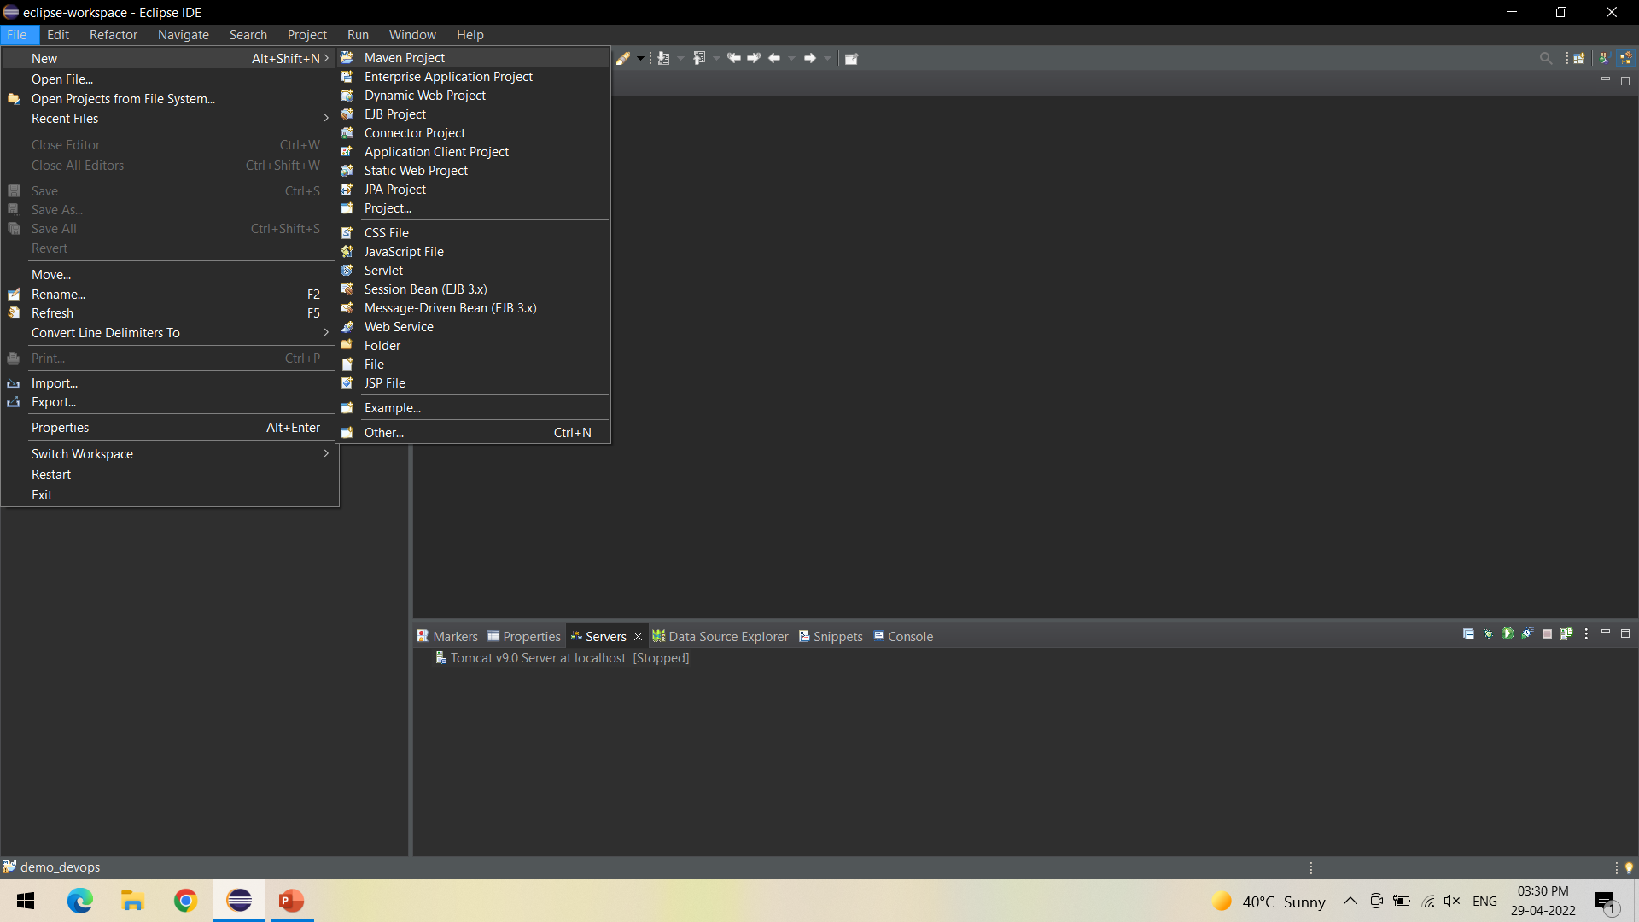
Create a Maven Project - > File - > New -> Maven Project

Slide 3
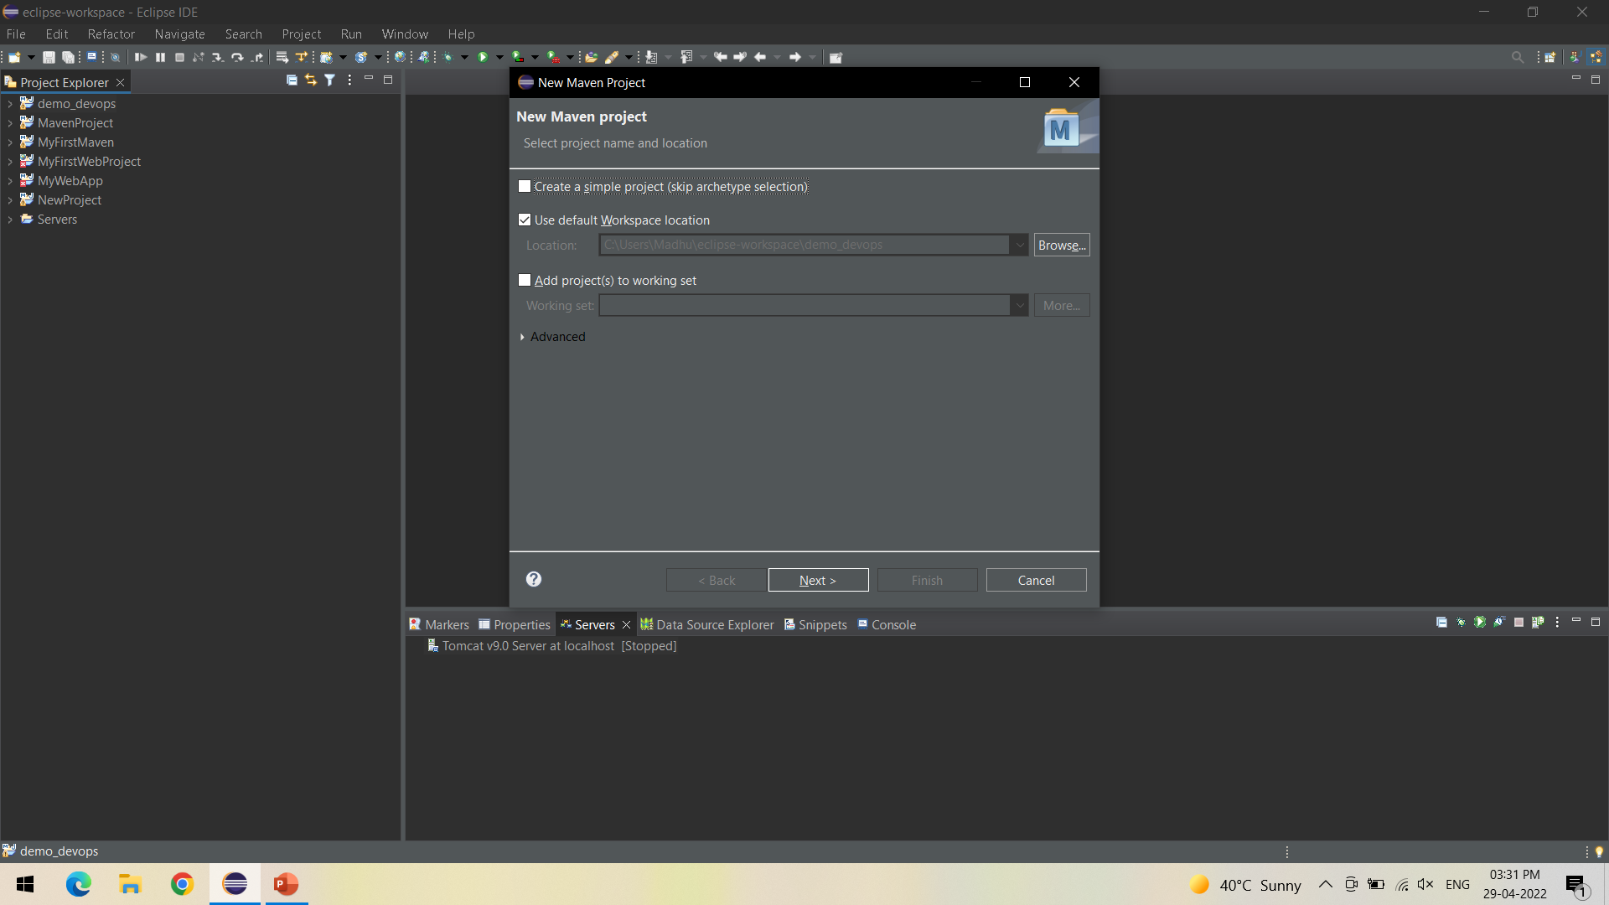
Click on Next

Slide 4
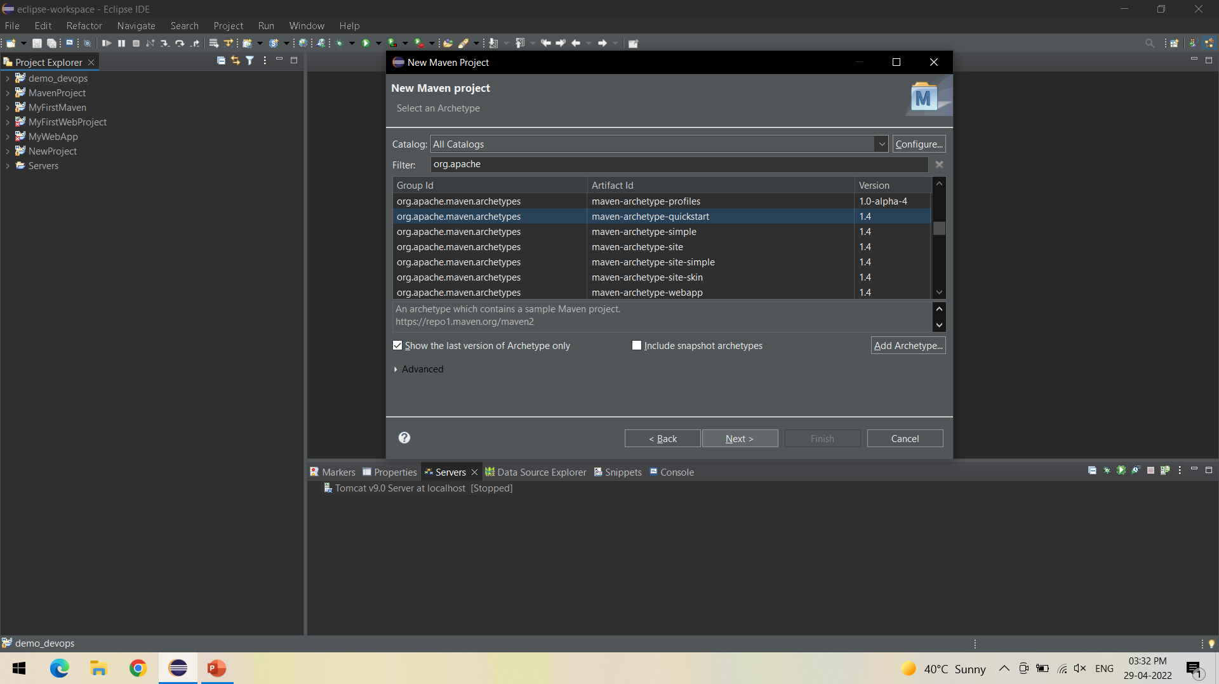
Select the quickstart archetype under org.apache.maven.archetypes and click on Next

Slide 5
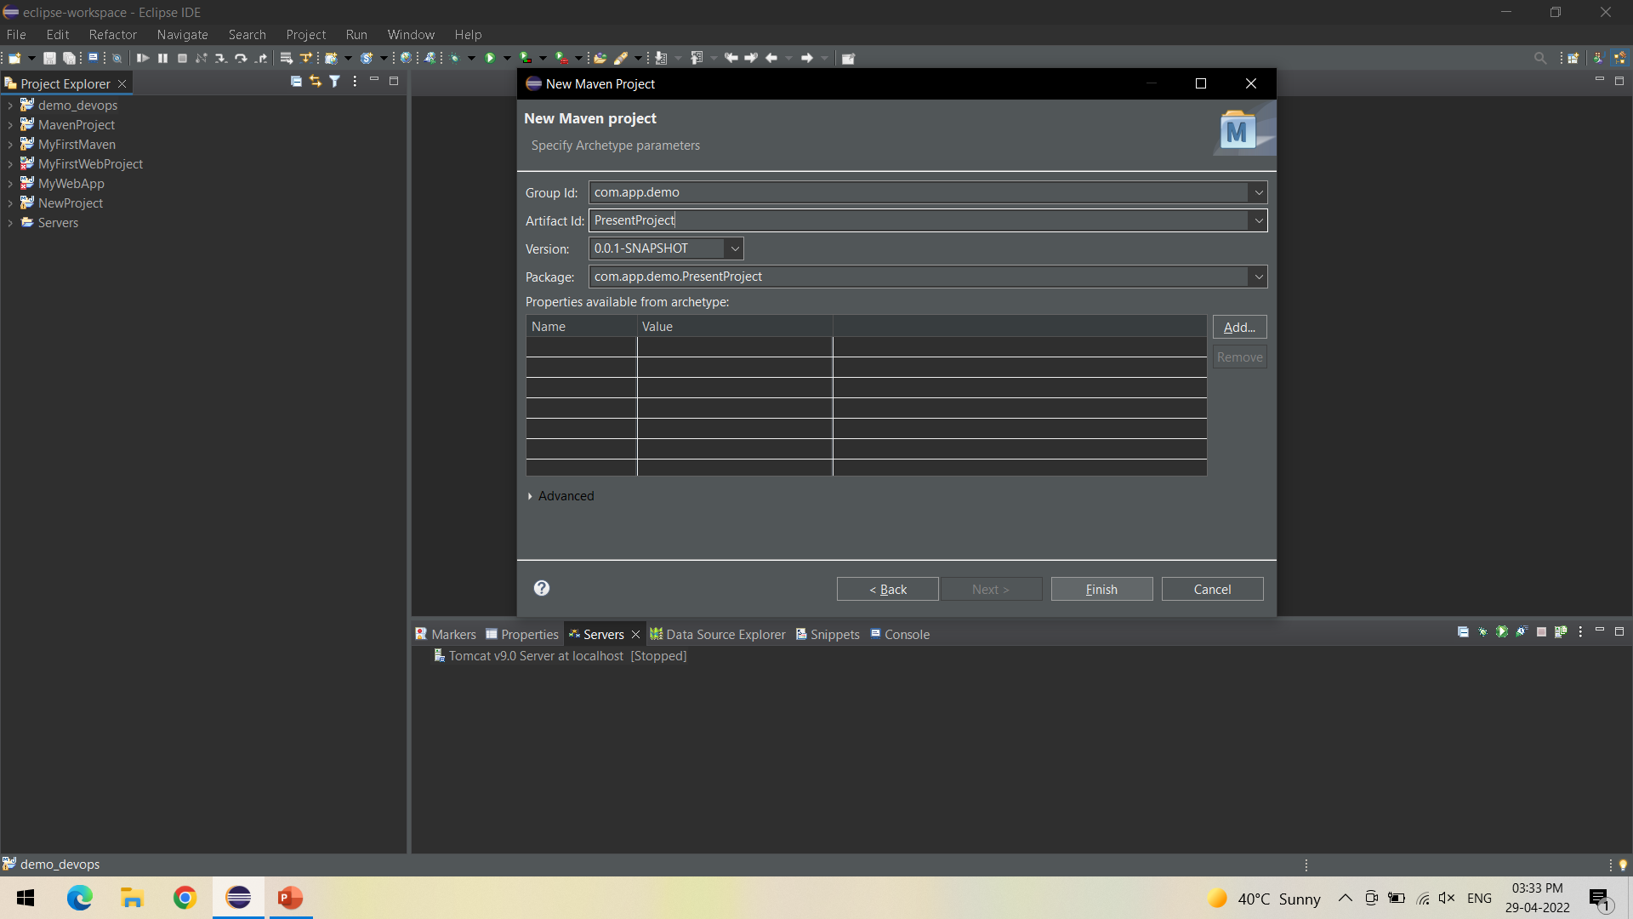
Give Artifact ID of your choice and click Finish, Maven Project is created

Slide 6
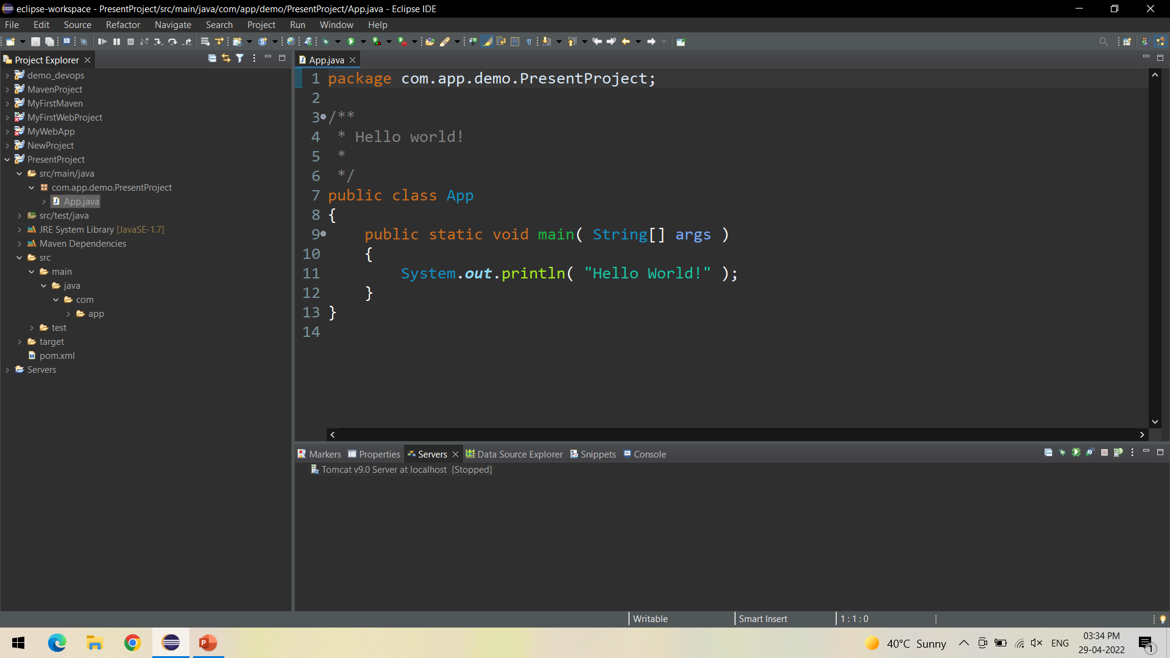
In the created project, Check for App.java file containing Hello World program

Slide 7
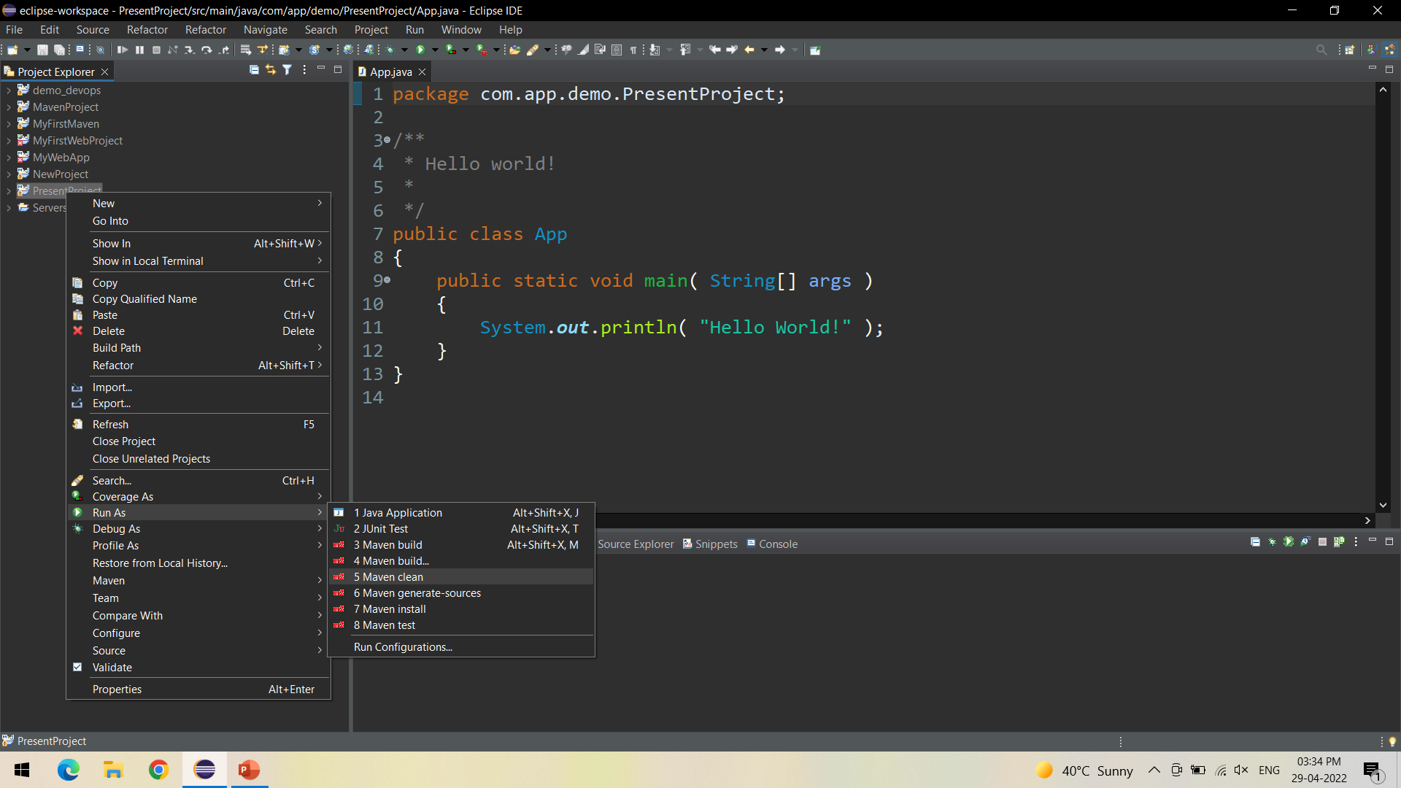
Right click on your project and Run As Maven Clean - It clears out the existing classes that you compiled from last compile

Slide 8
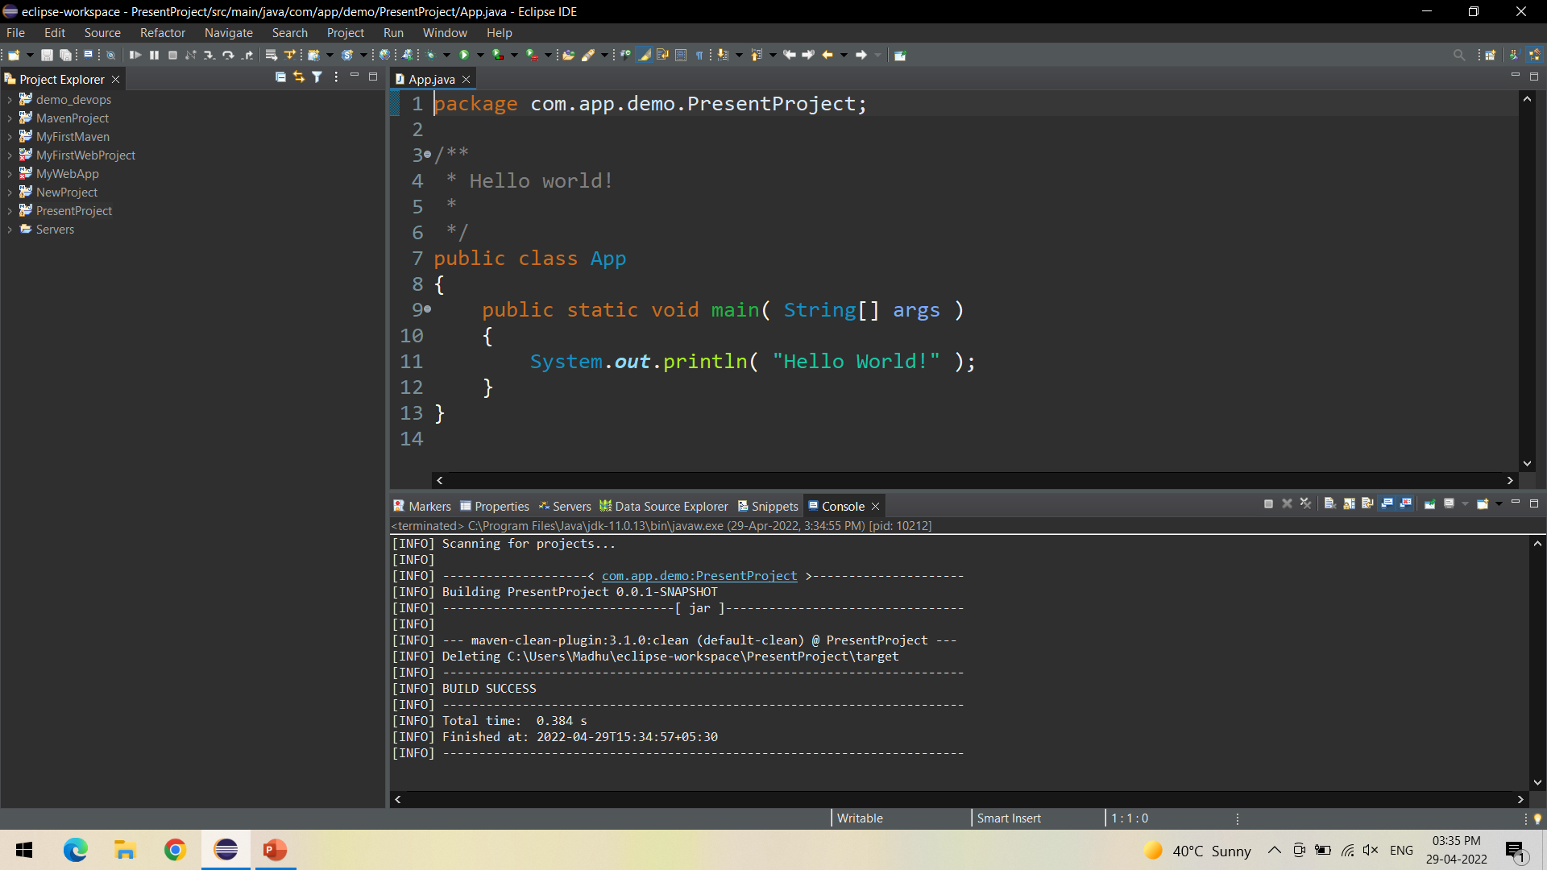
Check the console for Build Success

Slide 9
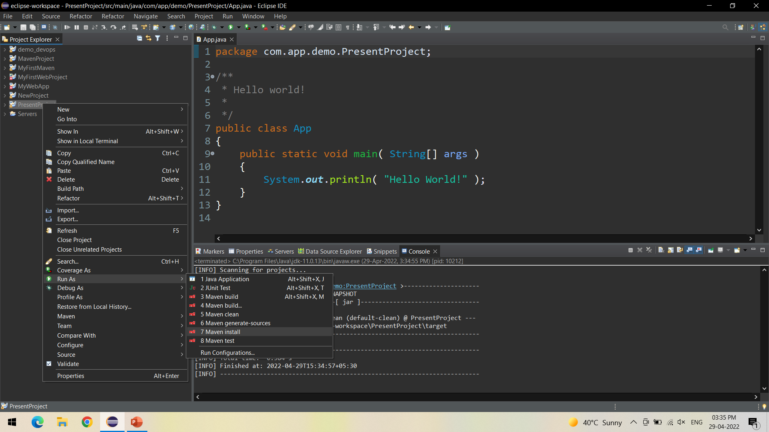
Right click on your project and Run As Maven Install - to add artifact(s) to the local repository

Slide 10
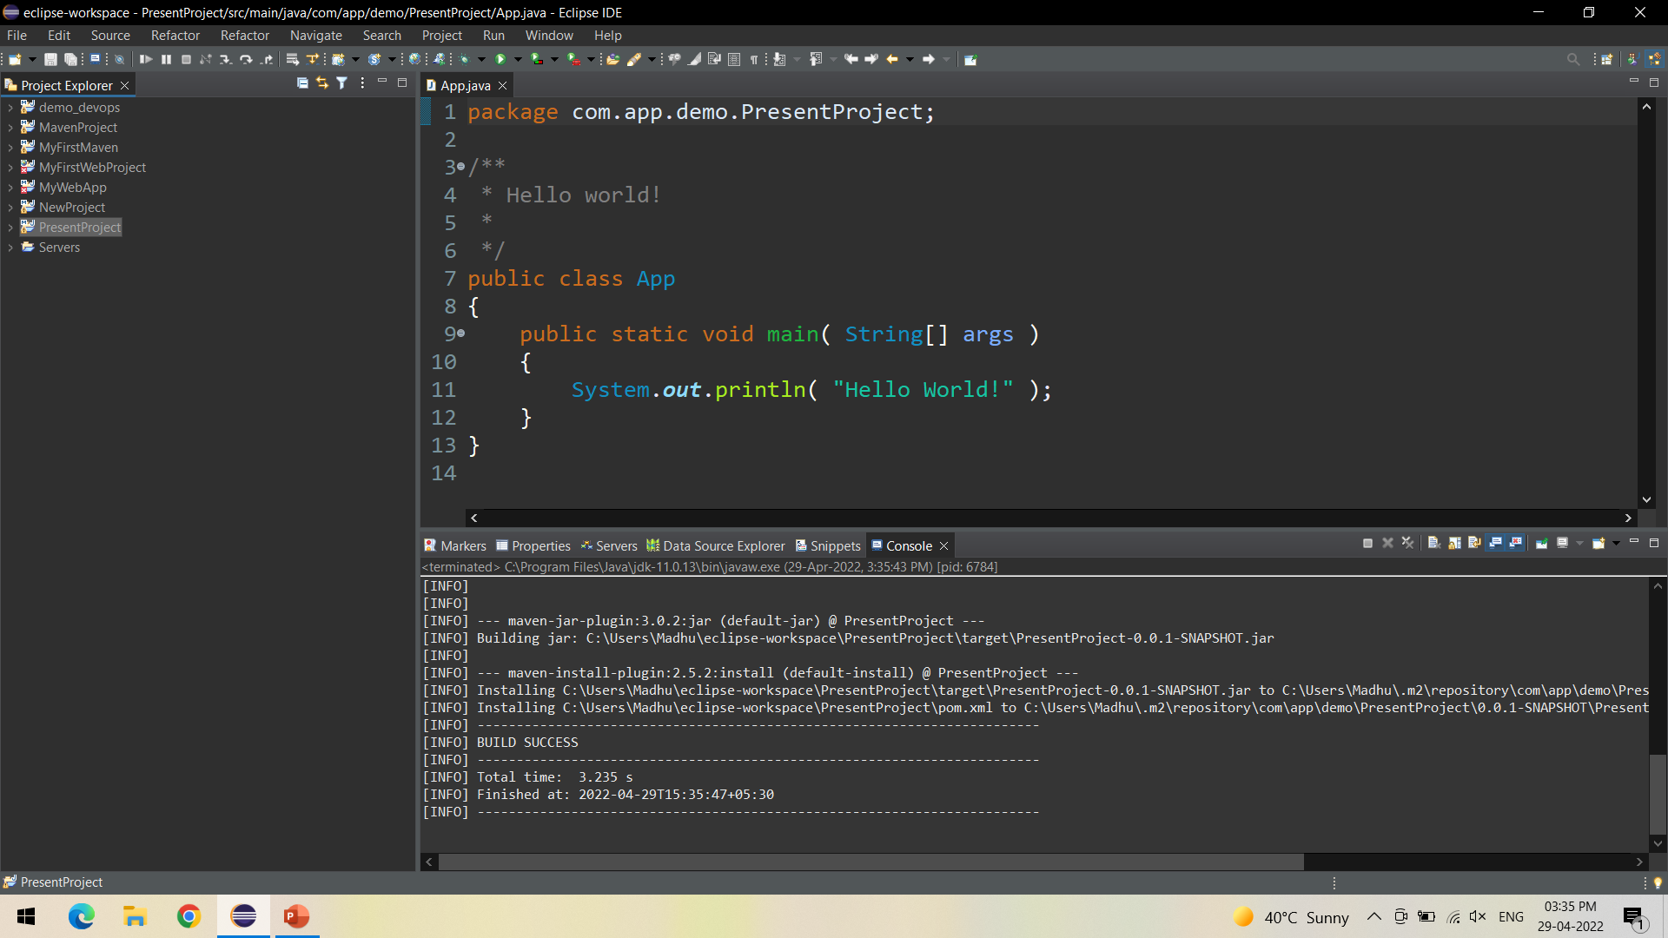
Check the console for Build Success

Slide 11
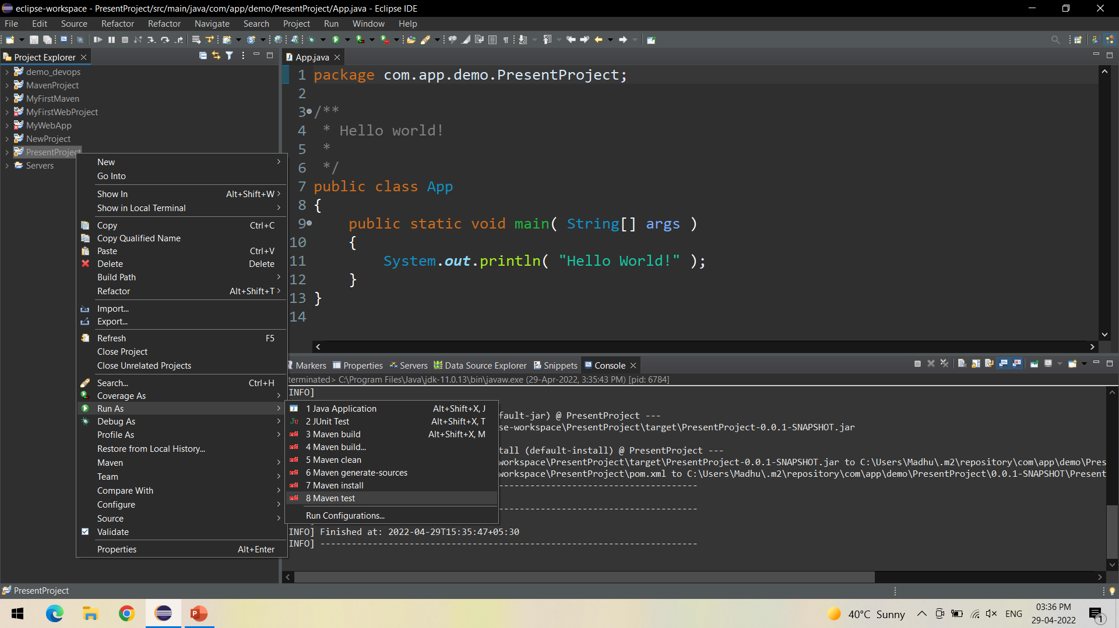
Right click on your project and Run As Maven Install - use to specify test classes or methods we want to execute

Slide 12
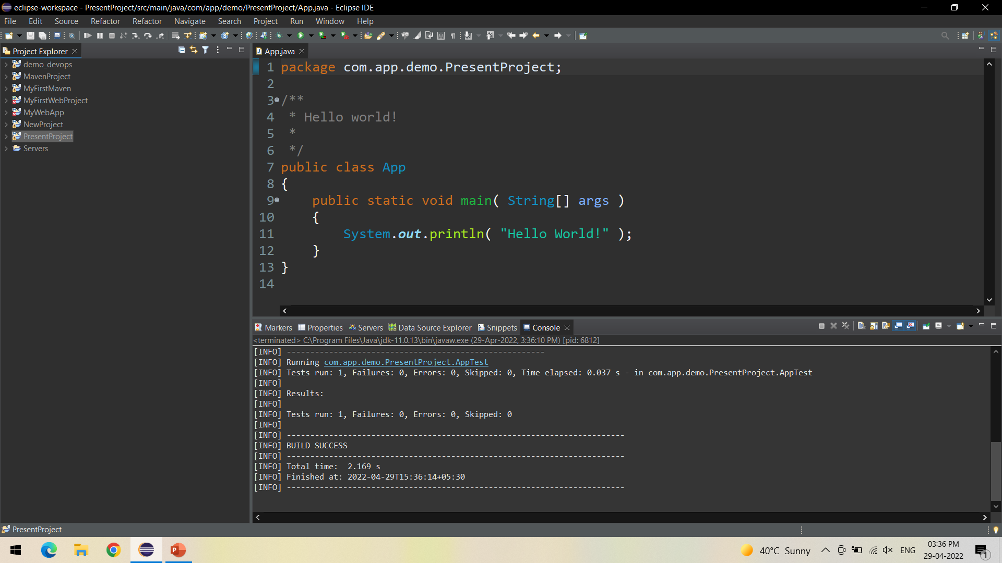
Check the console for Build Success

Slide 13
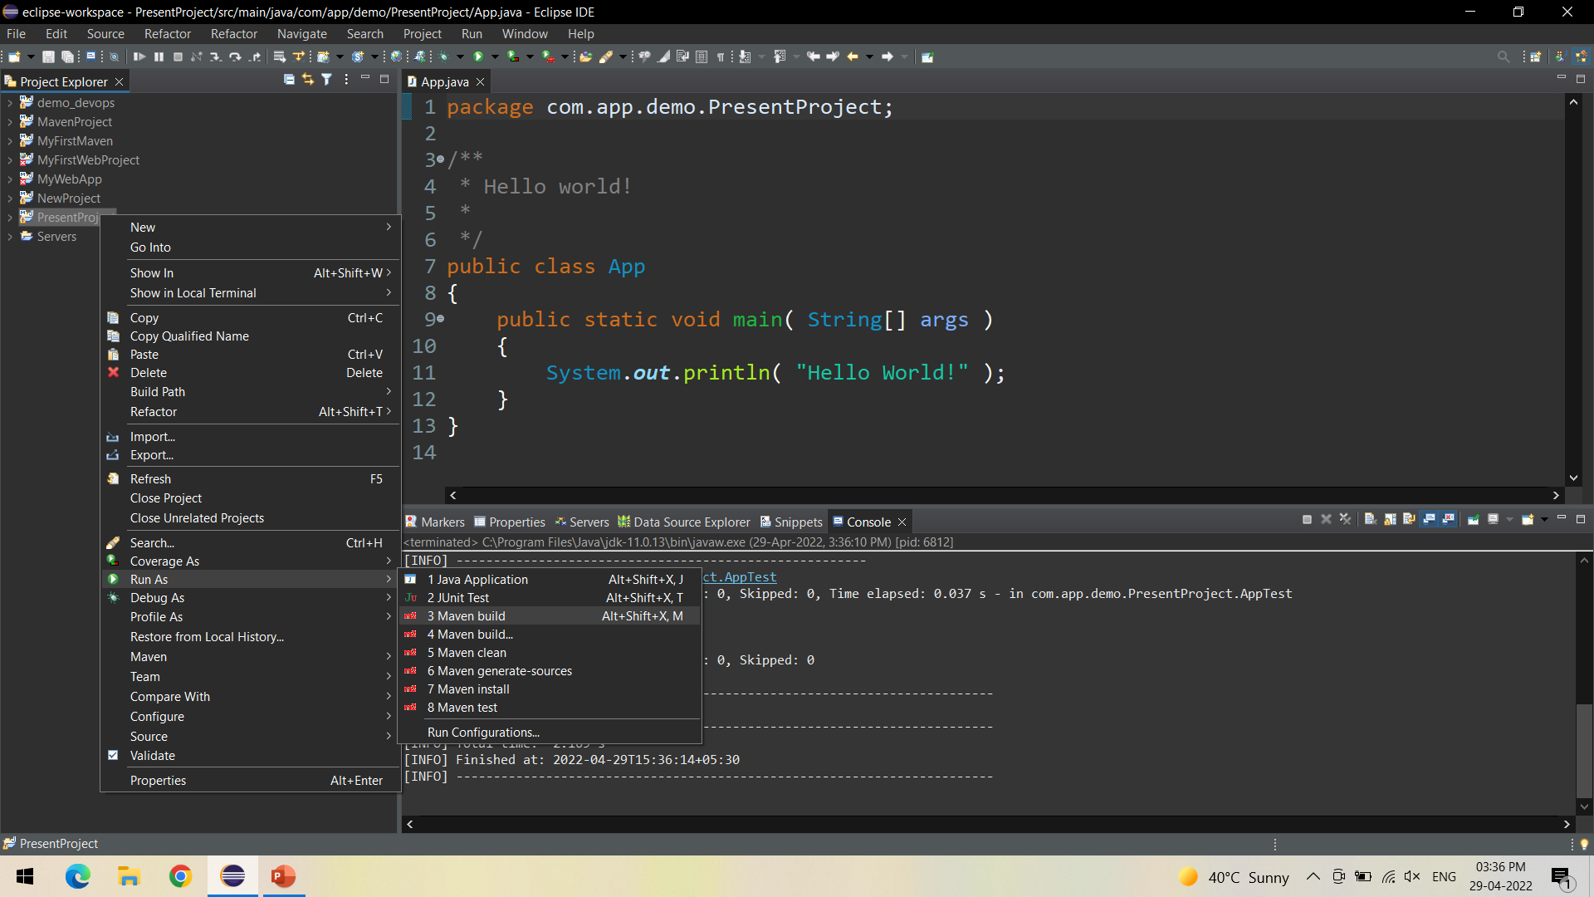
Right click on your project and Run As Maven Install - Compiles source code of the project, Creates JAR or WAR file for the project to convert it into a distributable format.

Slide 14
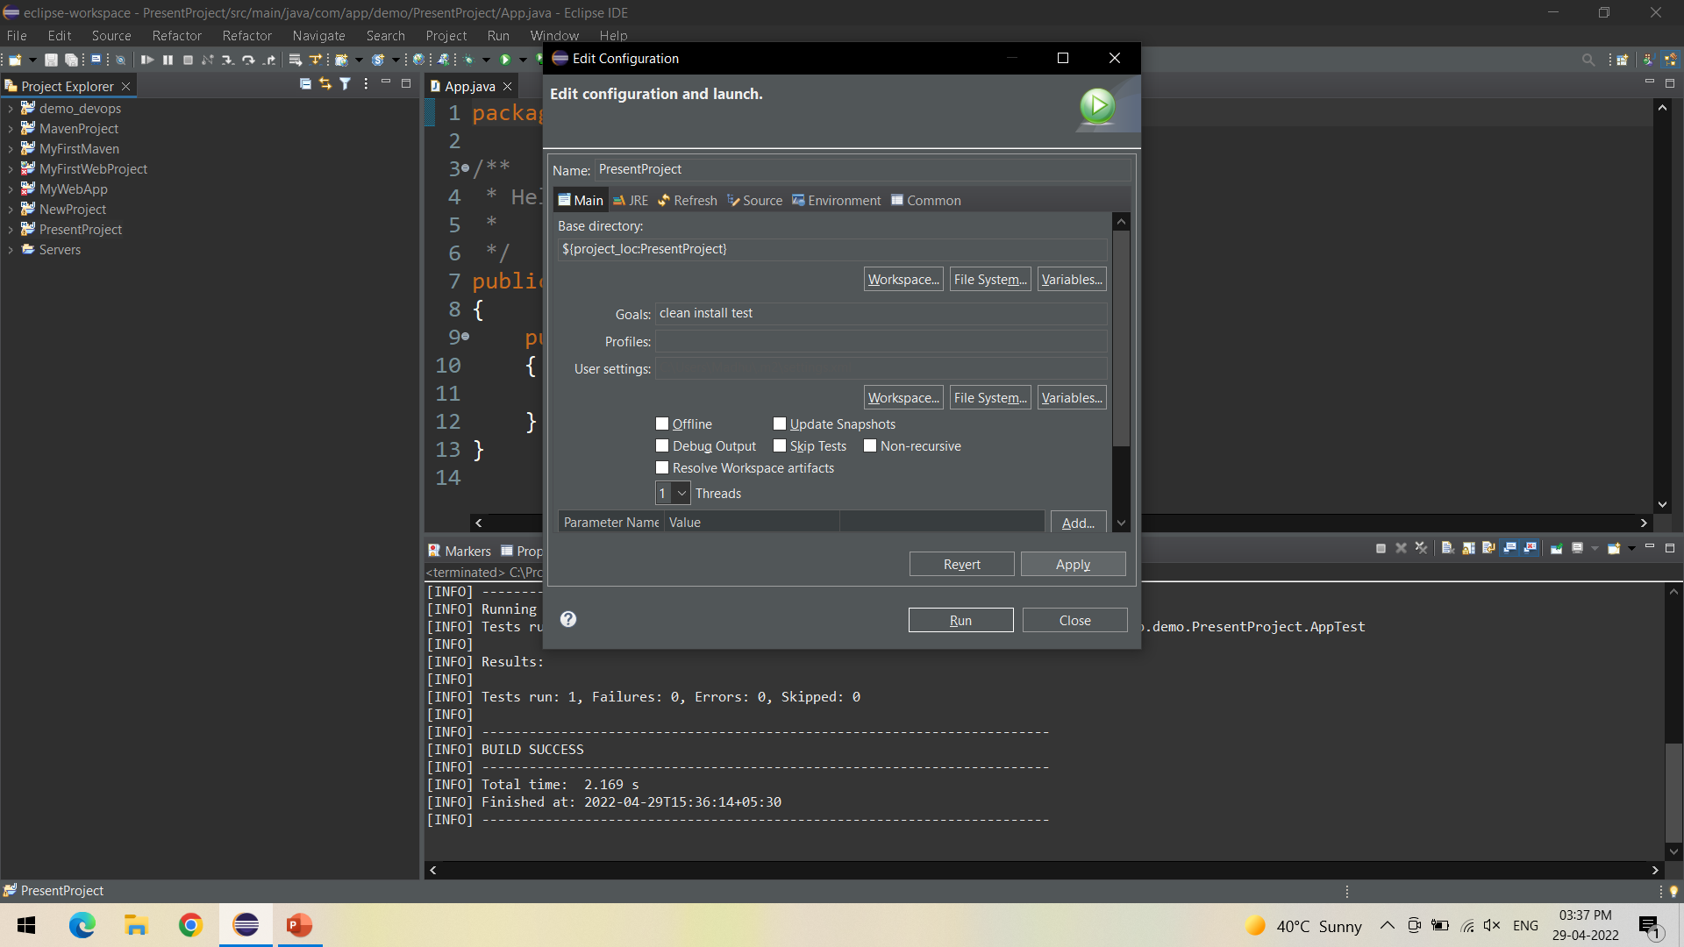
Specify the goals as – Clean Install Test -> Click on Apply

Slide 15

Click on Run

Slide 16
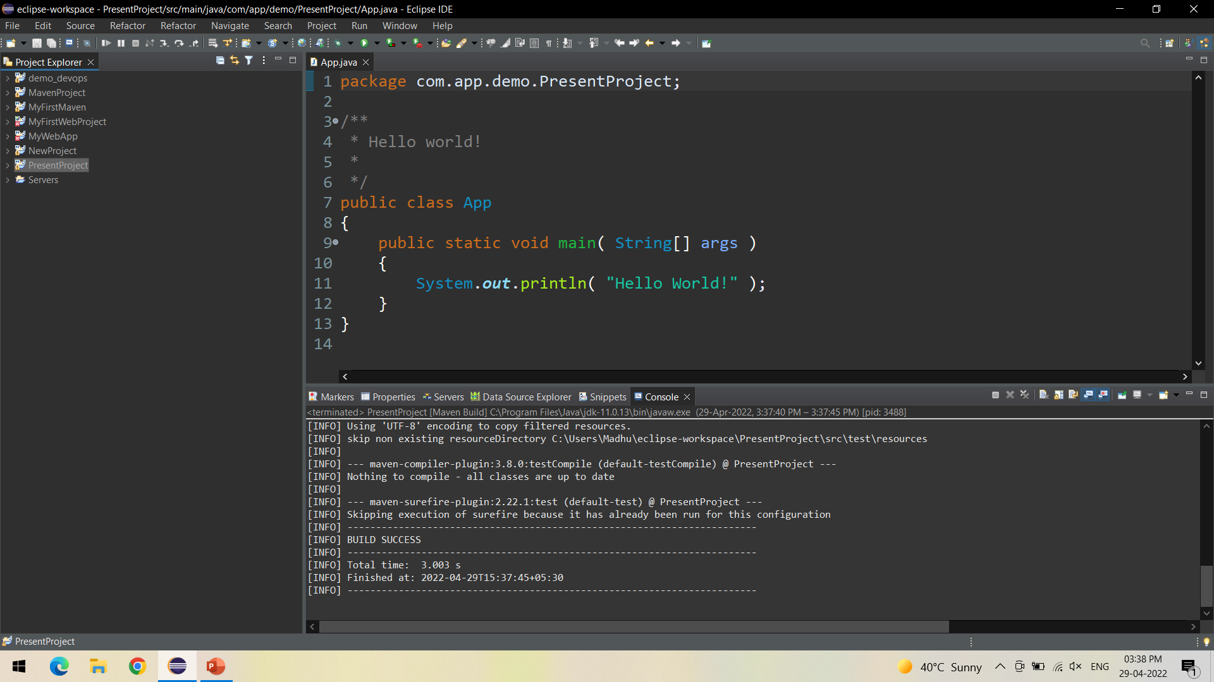
Check for Build Success in Console

Slide 17
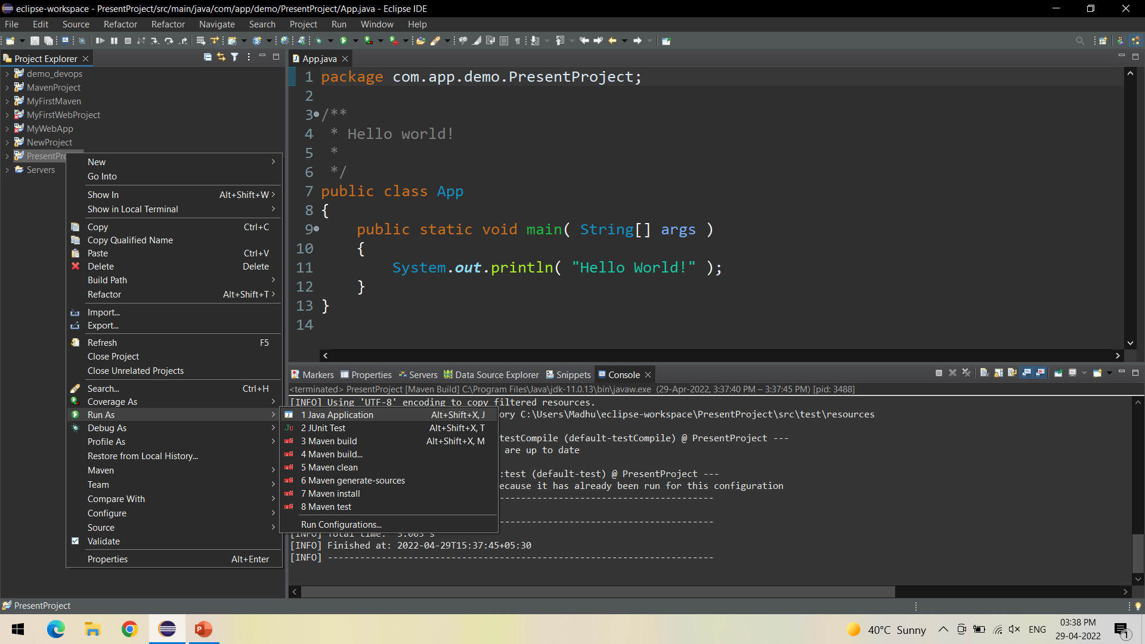
Now Run the Project as Java Application to test the output

Slide 18
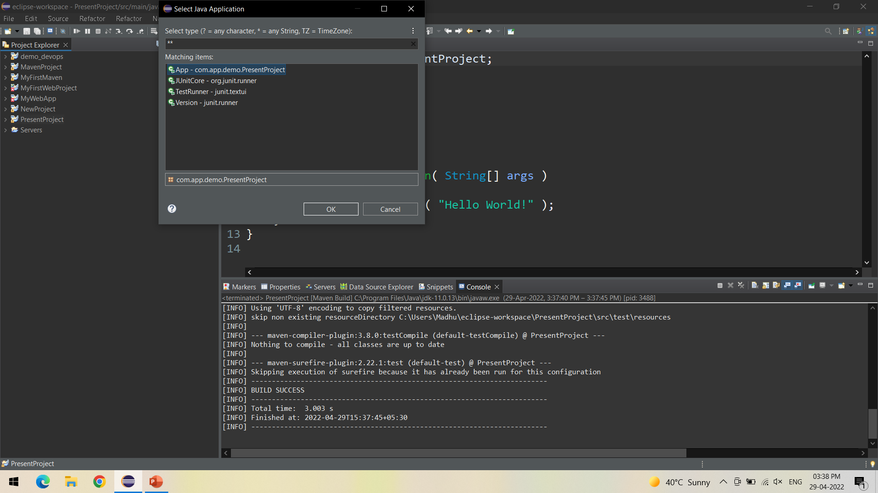
Select the Created project from the list - > Click Ok

Slide 19
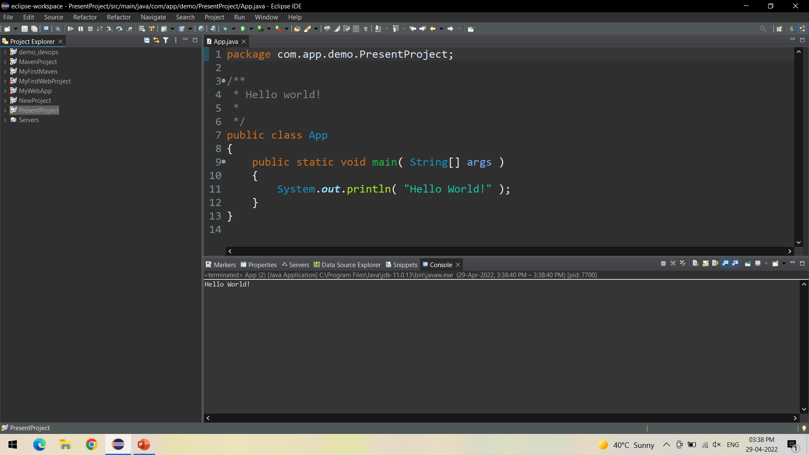
In the console we can view the output of the project

Slide 20
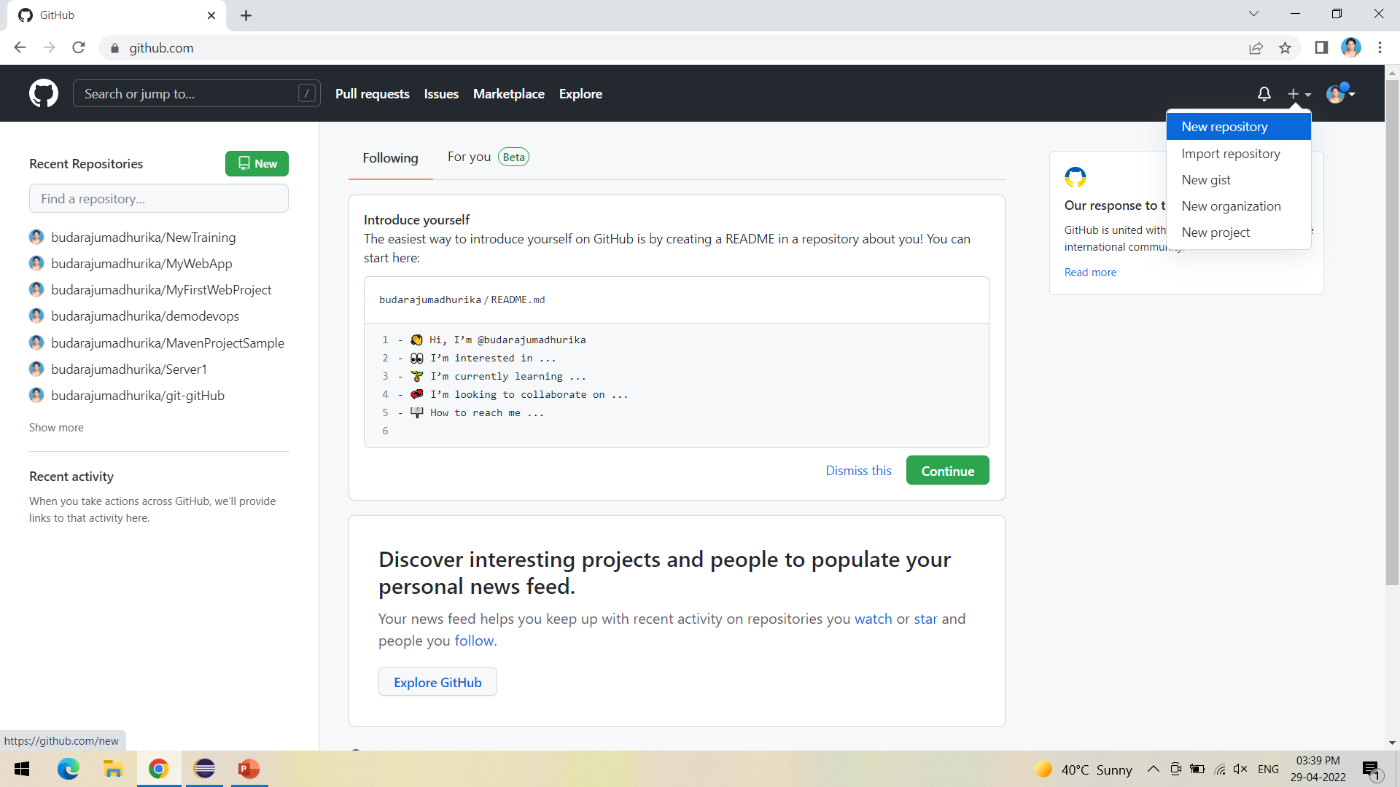
Next is to push the project into GitHub, for this, create a new repository in GitHub

Slide 21
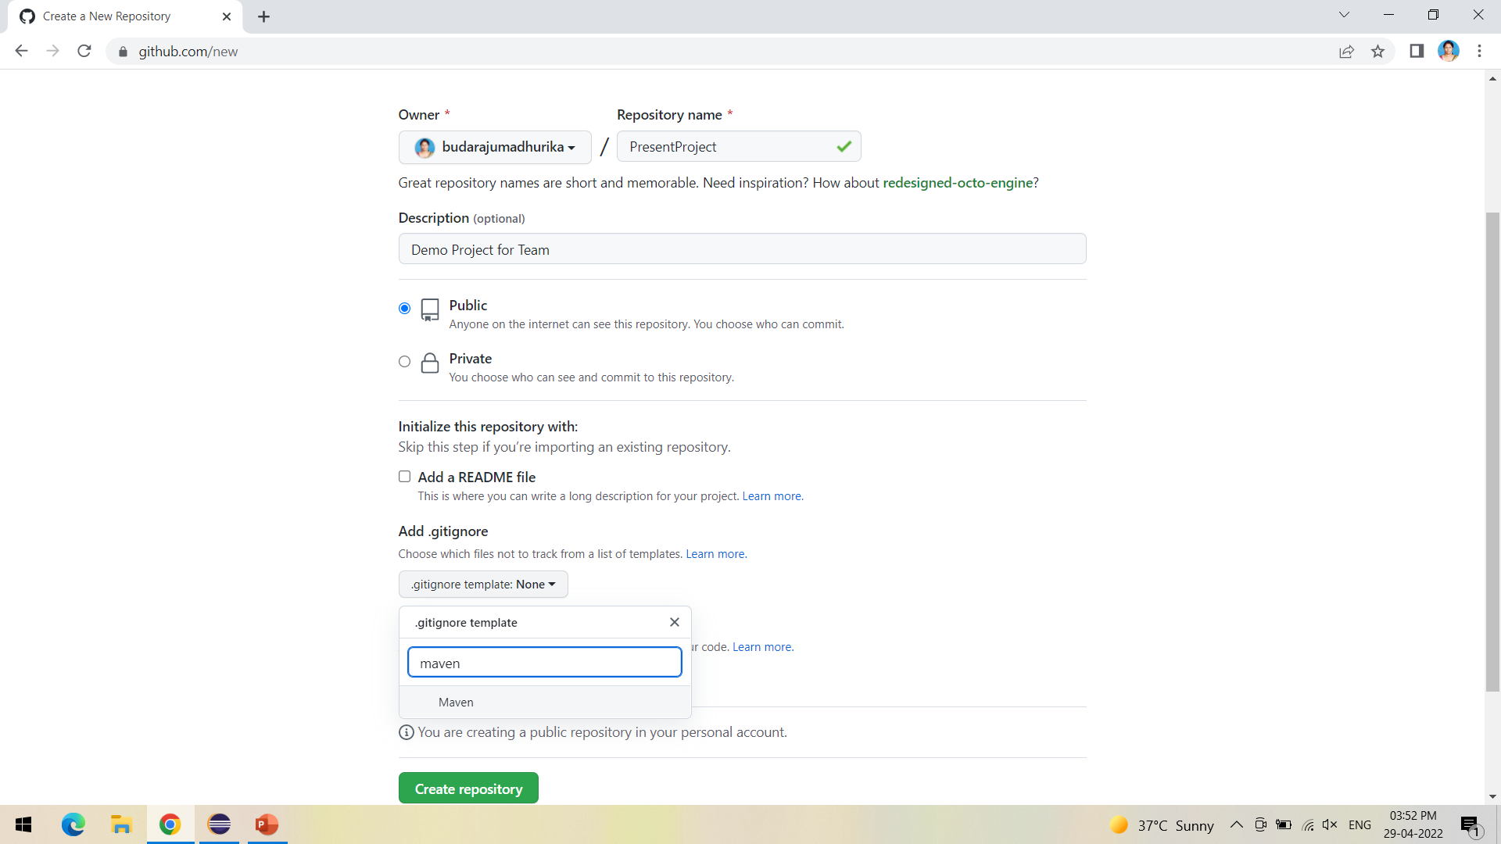
Select Maven in gitignore- to ignore unwanted target files in maven project while committing

Slide 22
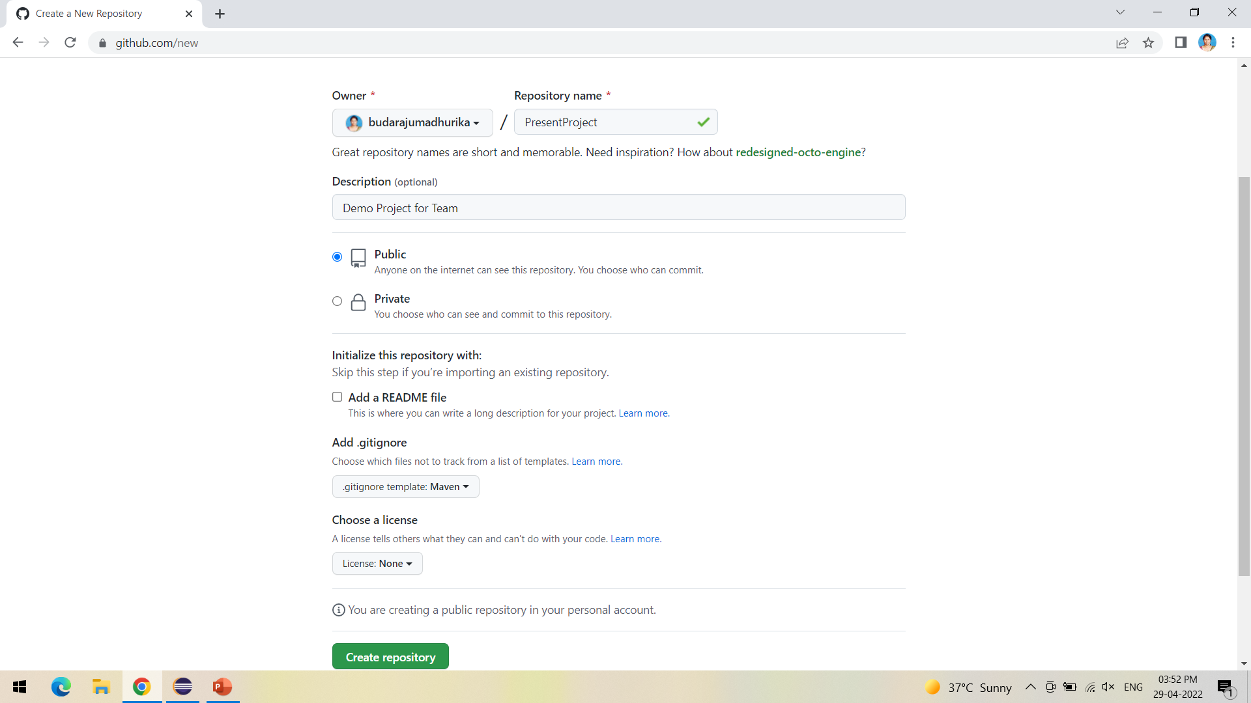
Click on create repository

Slide 23
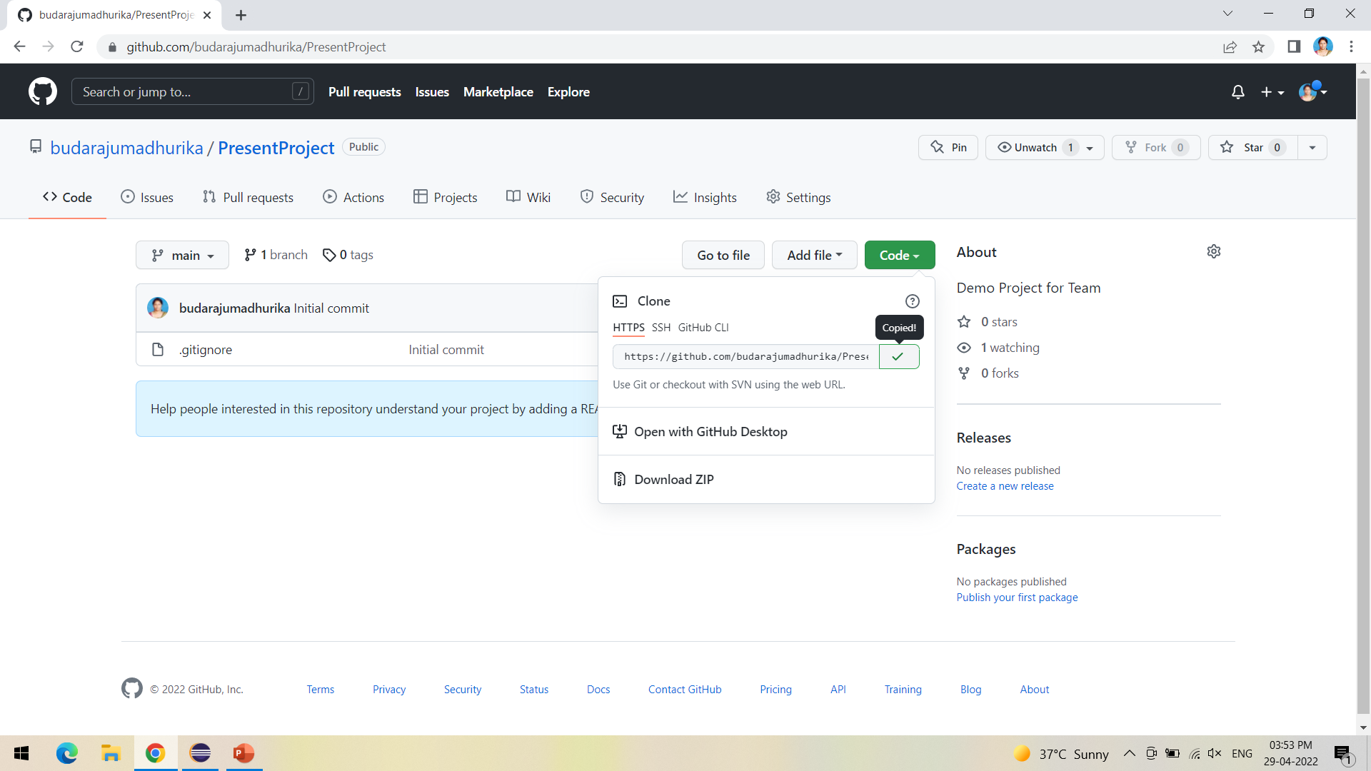
Copy the HTTPs URL as shown to be copied into Jenkins

Slide 24
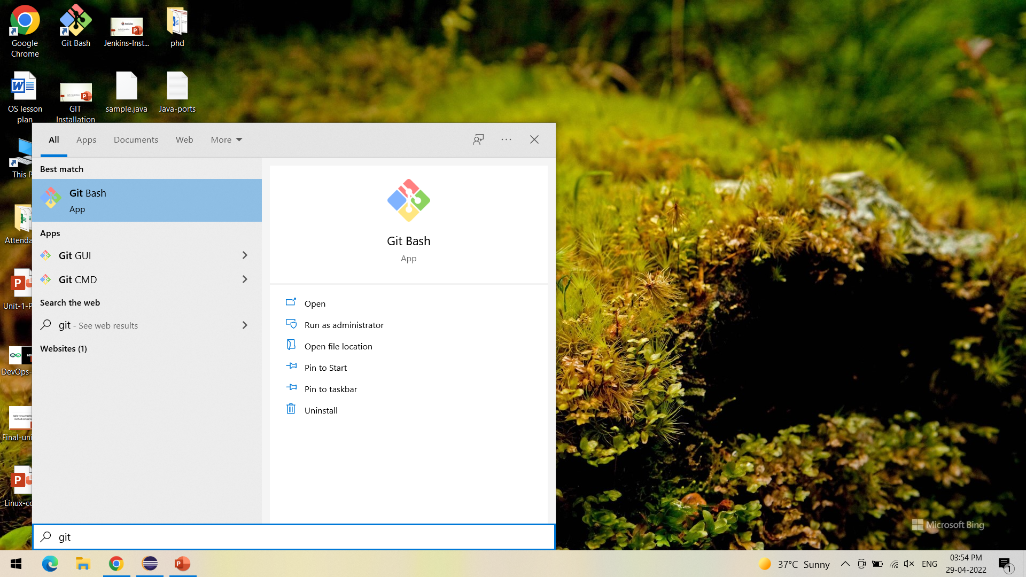
Open Git Bash to push the project into GitHub

Slide 25
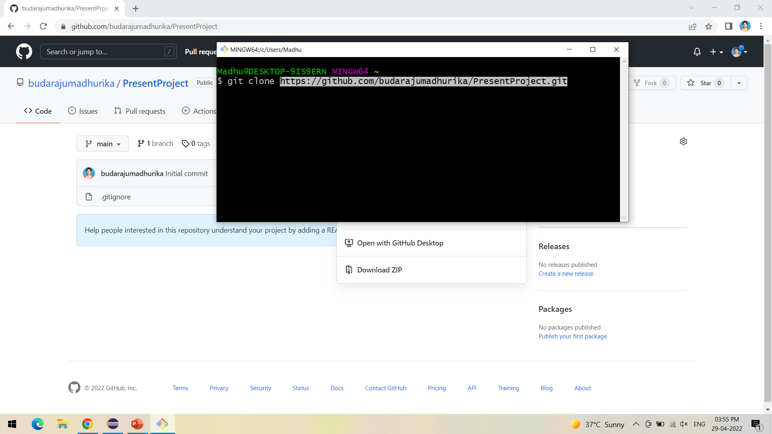
Clone the GitHub repository into the local system

Slide 26
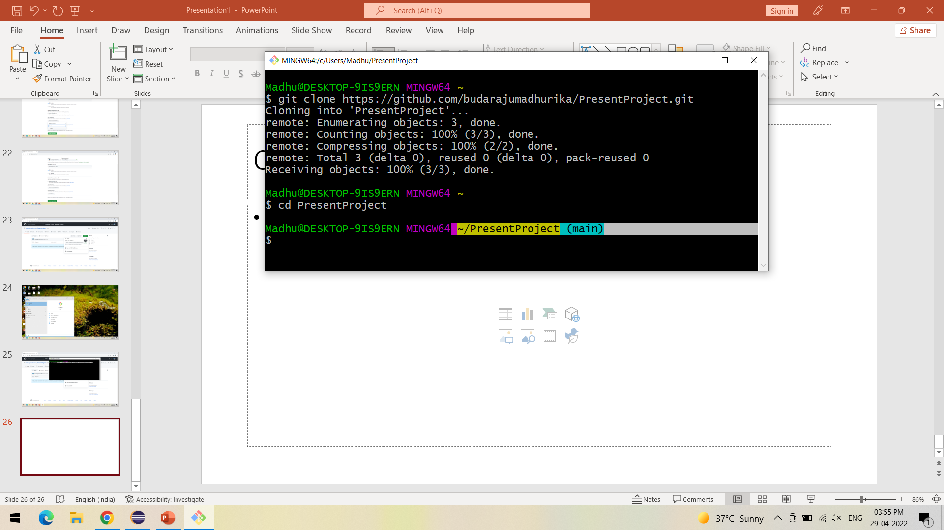
After cloning follow the steps as shown

Slide 27
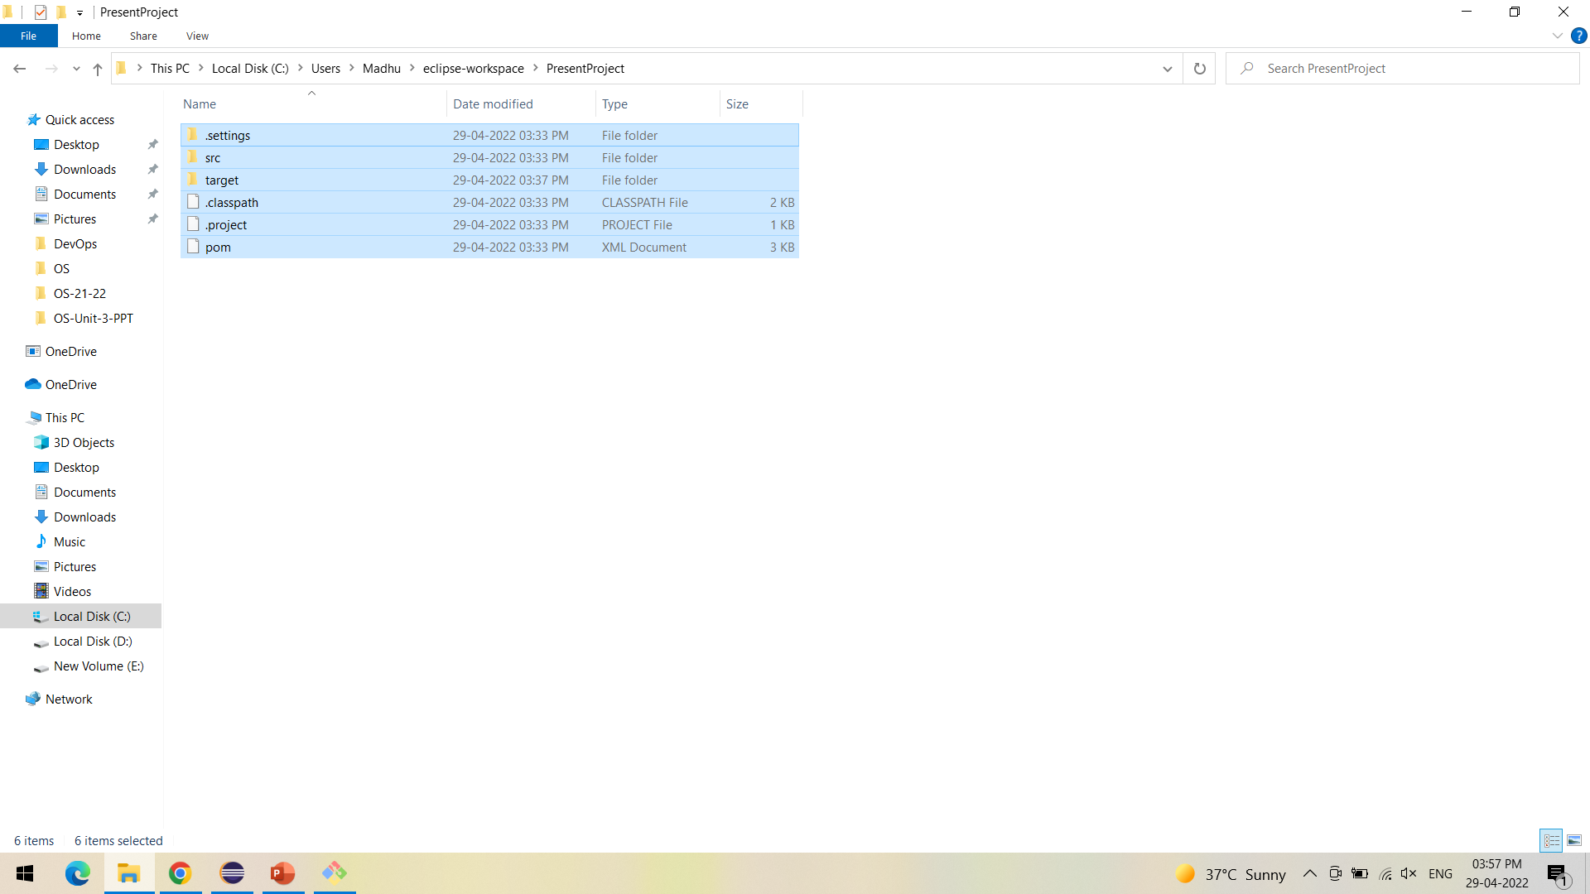
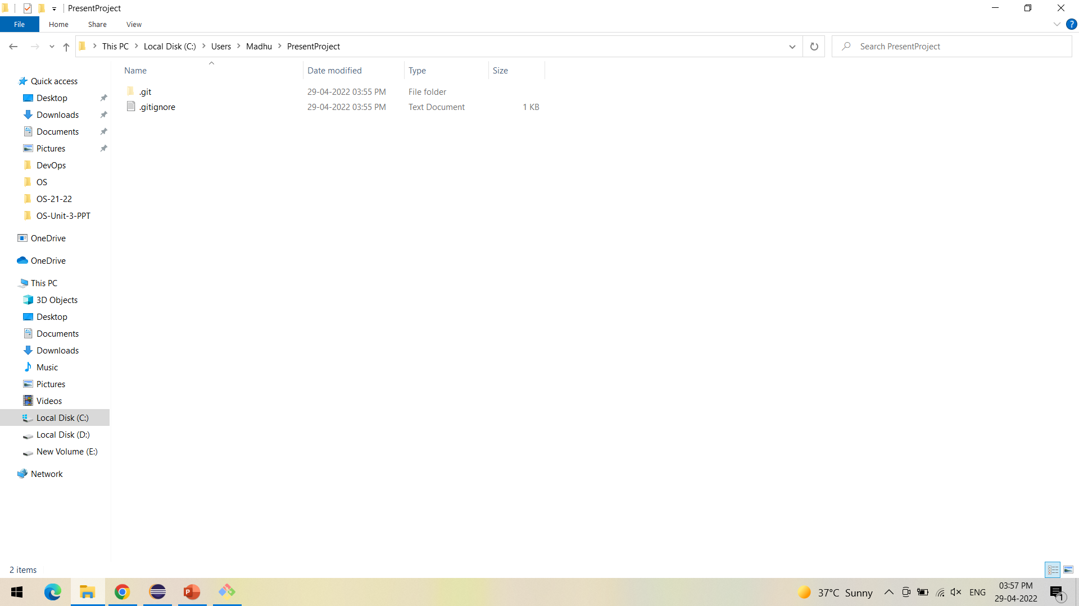
One way of cloning the local and global projects is to copy the contents from eclipse workspace to the local cloned repository as shown

Slide 28
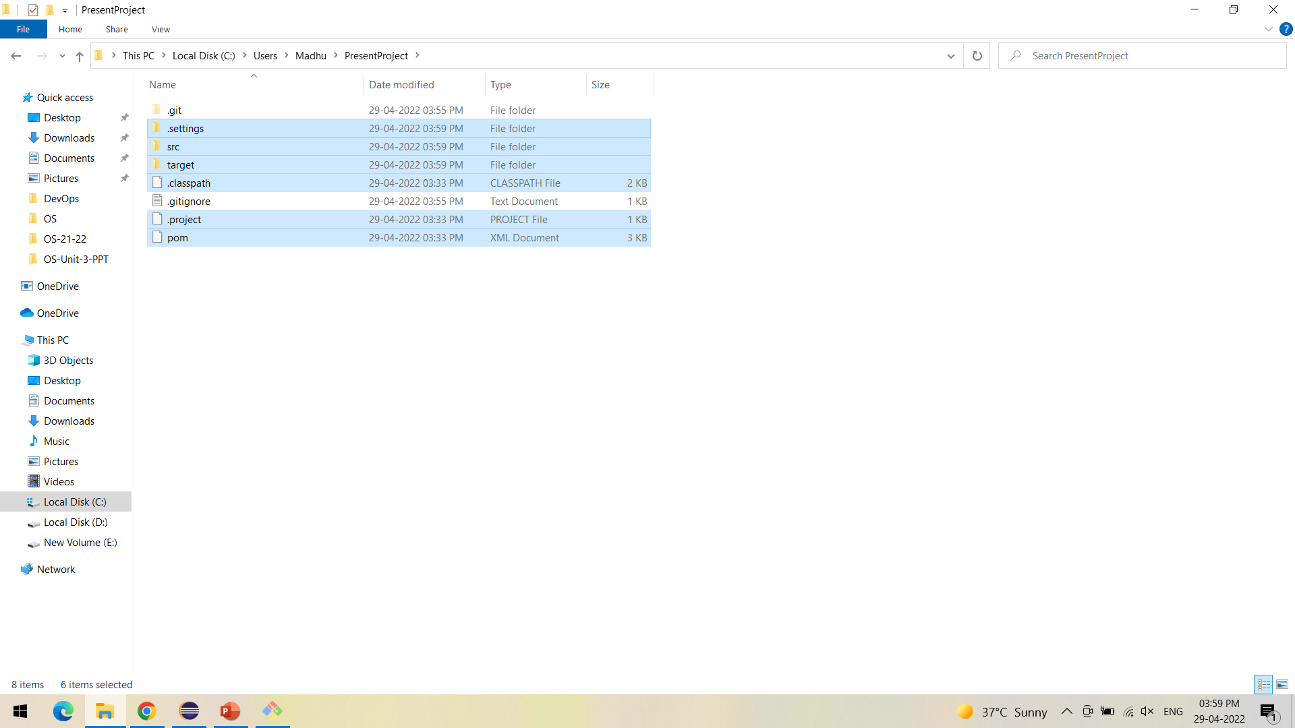
The project files are successfully copied into the PresentProject repository

Slide 29
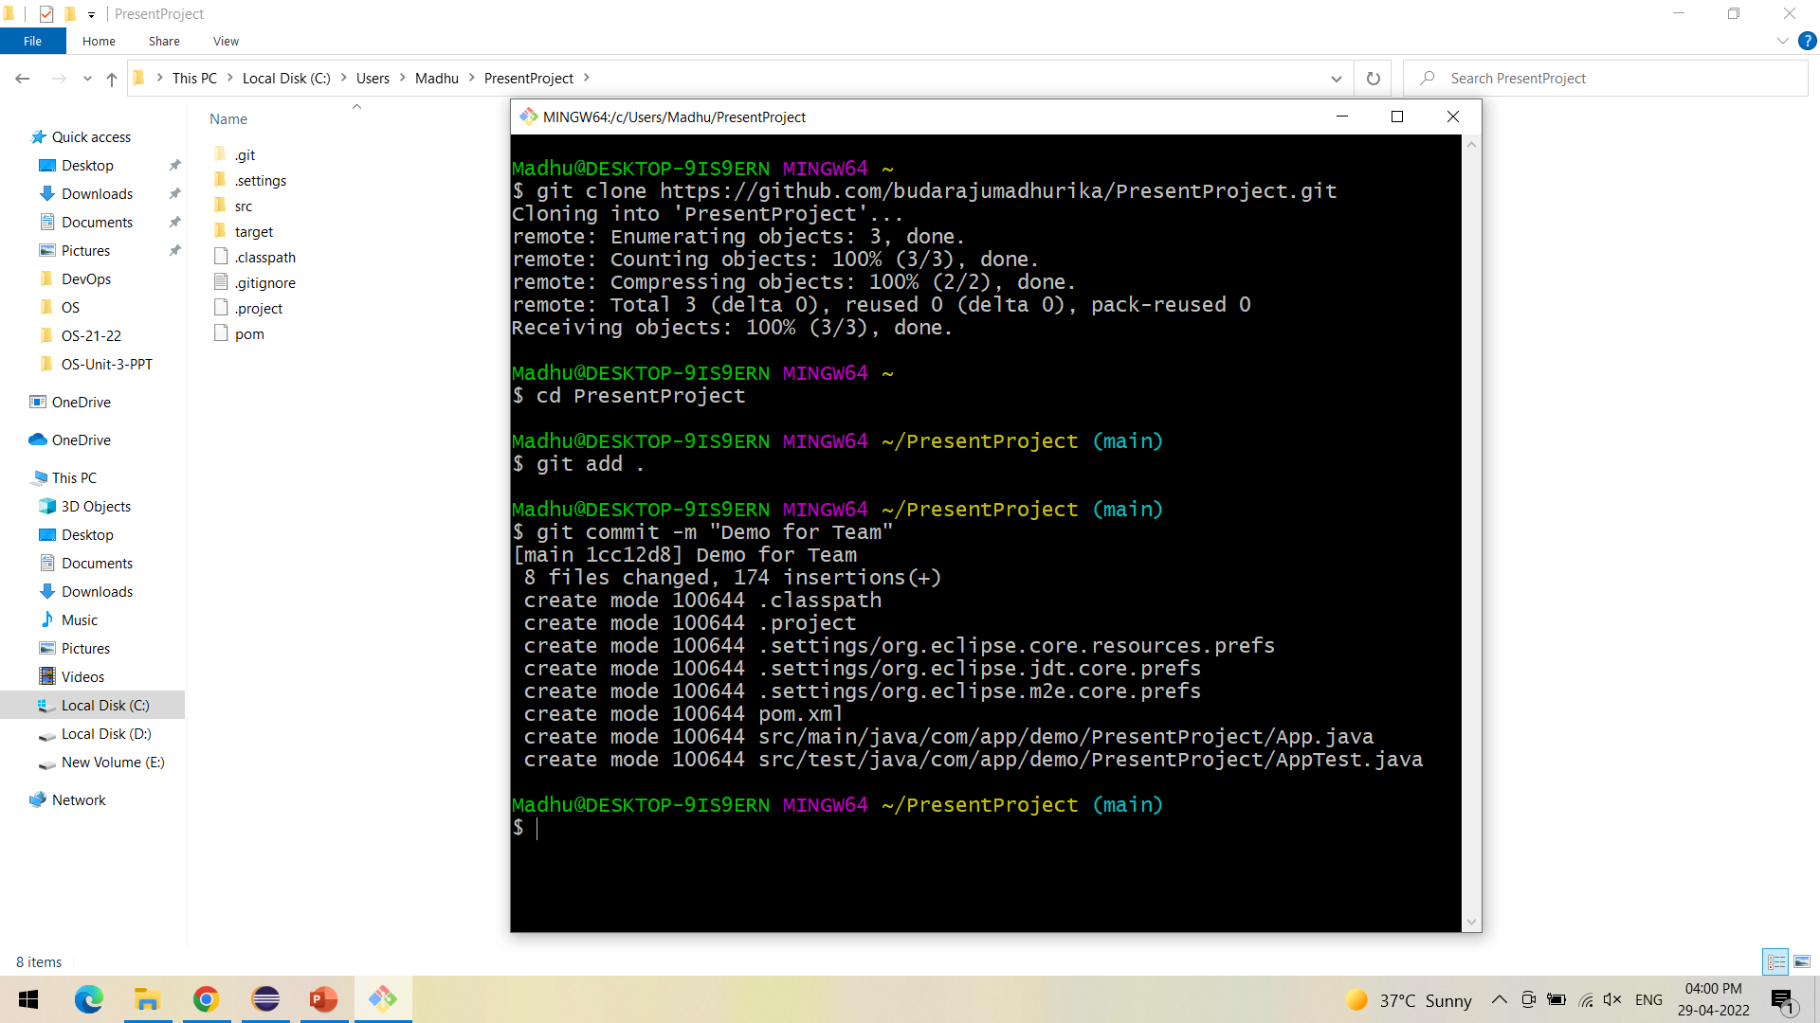
Using Git bash, add and commit the changes made as shown

Slide 30
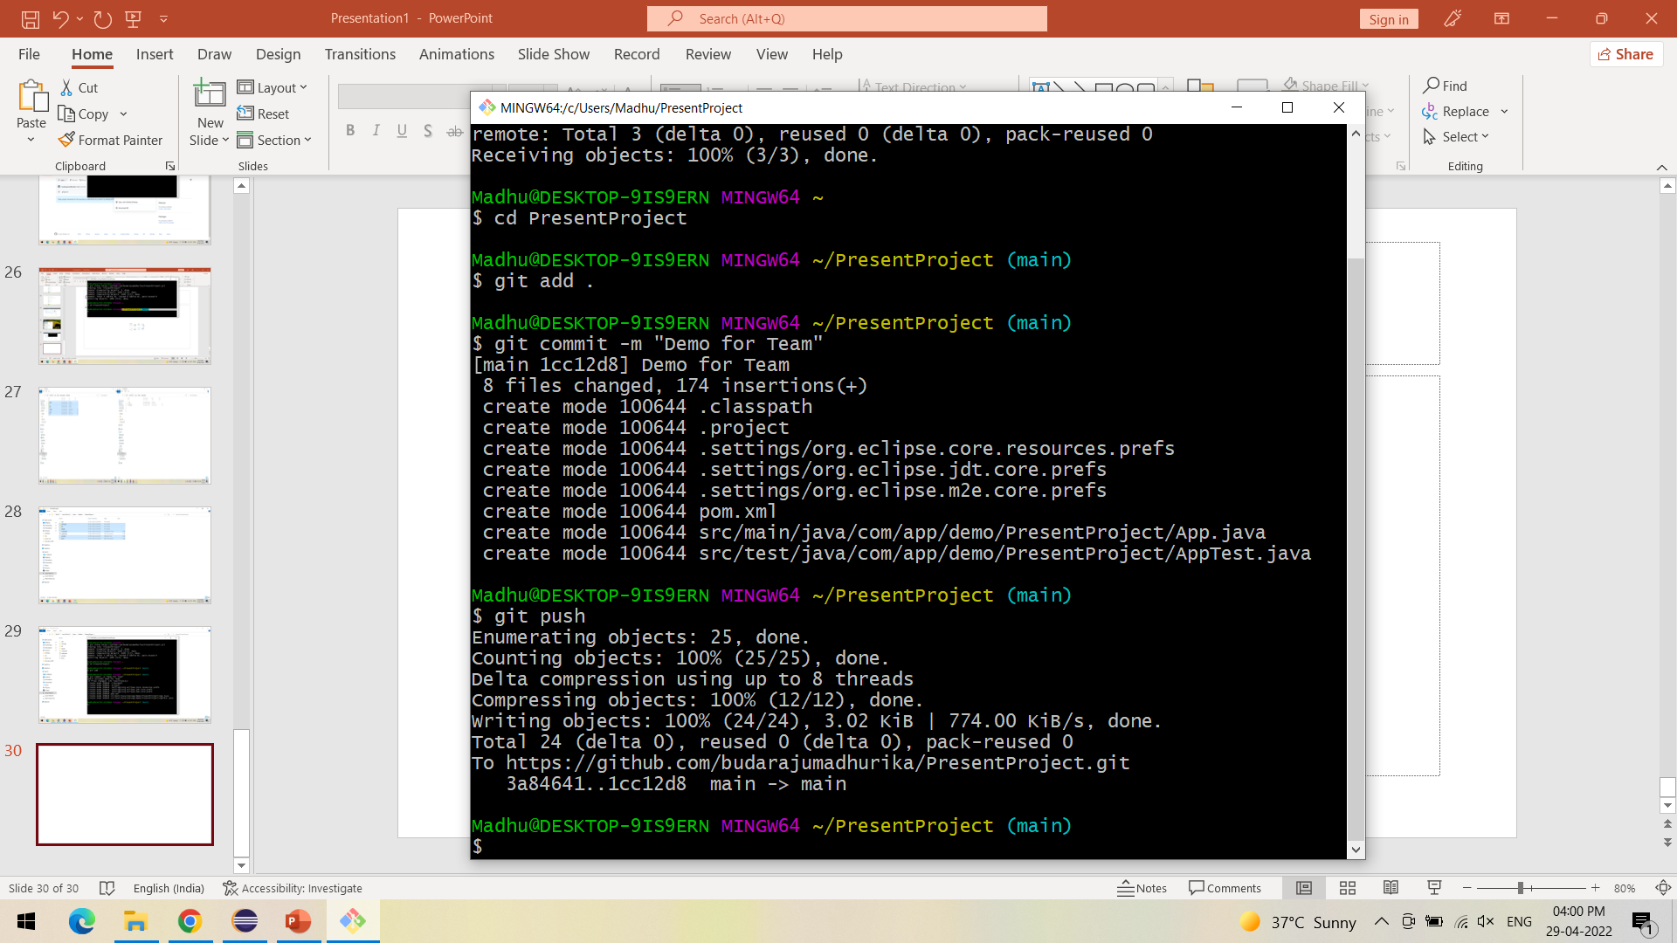
Push the changes to the GitHub as shown

Slide 31
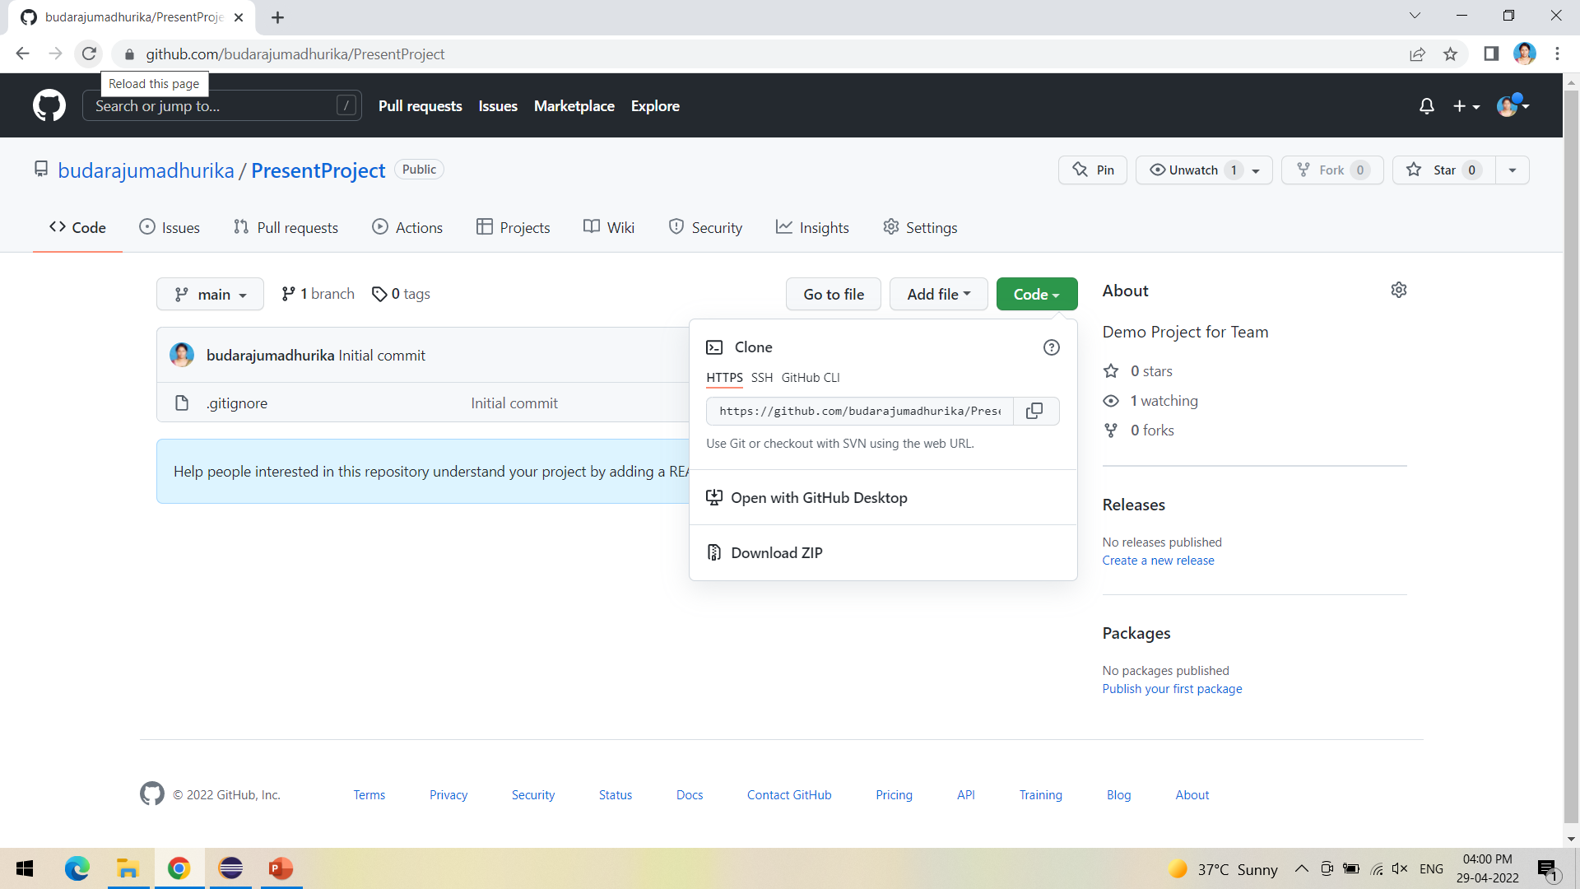
Refresh the GitHub to see the updated repository

Slide 32
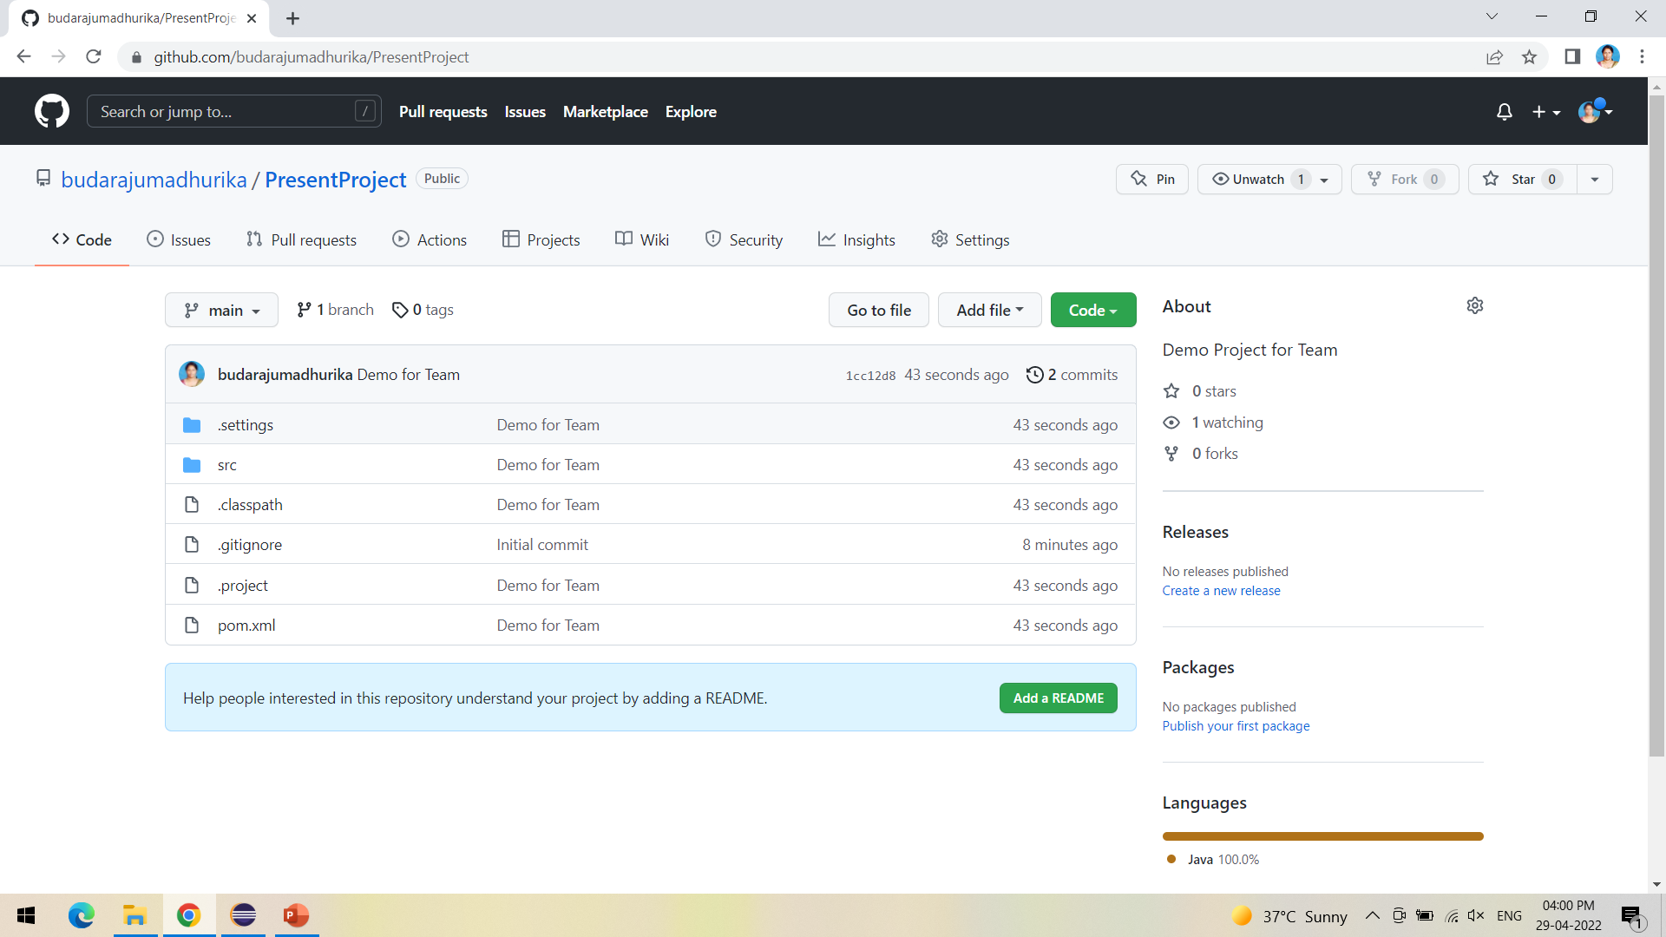
Repository is successfully updated

Slide 33
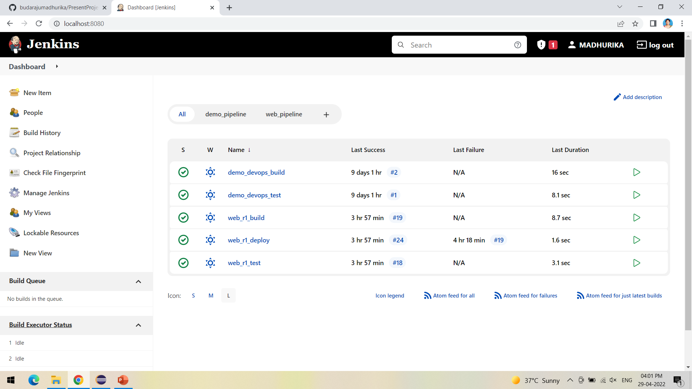
Open Jenkins in local host:8080 and create a new item

Slide 34
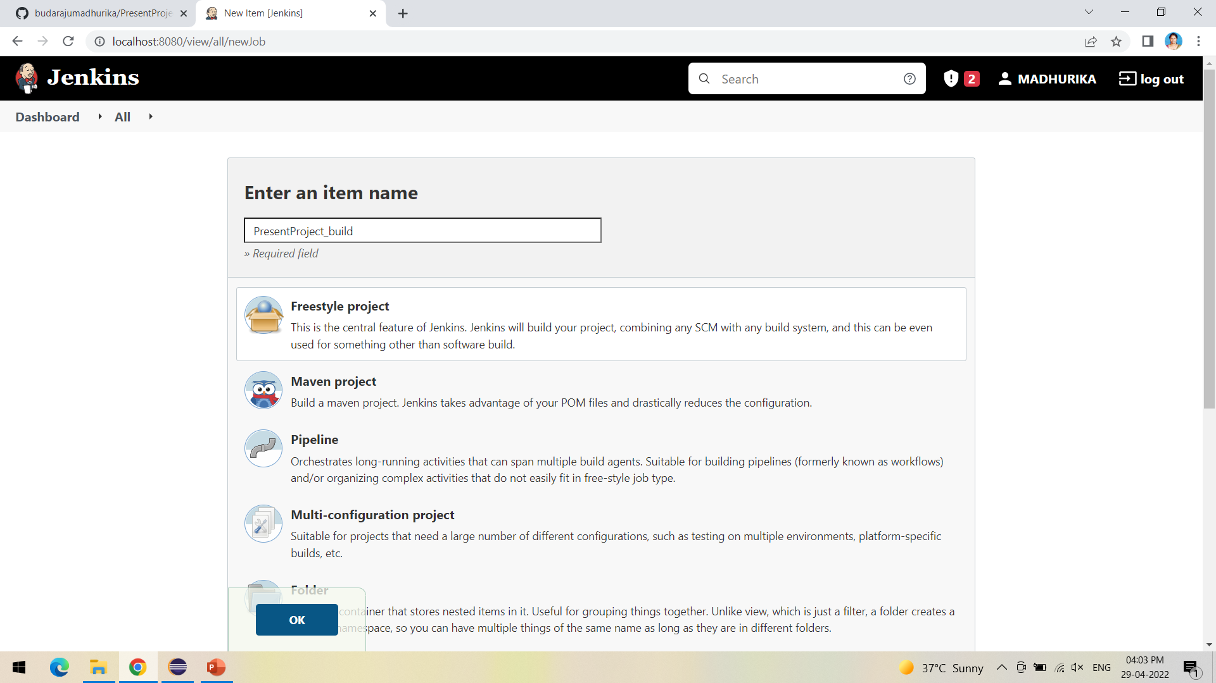
Create a new Freestyle Project and click ok

Slide 35
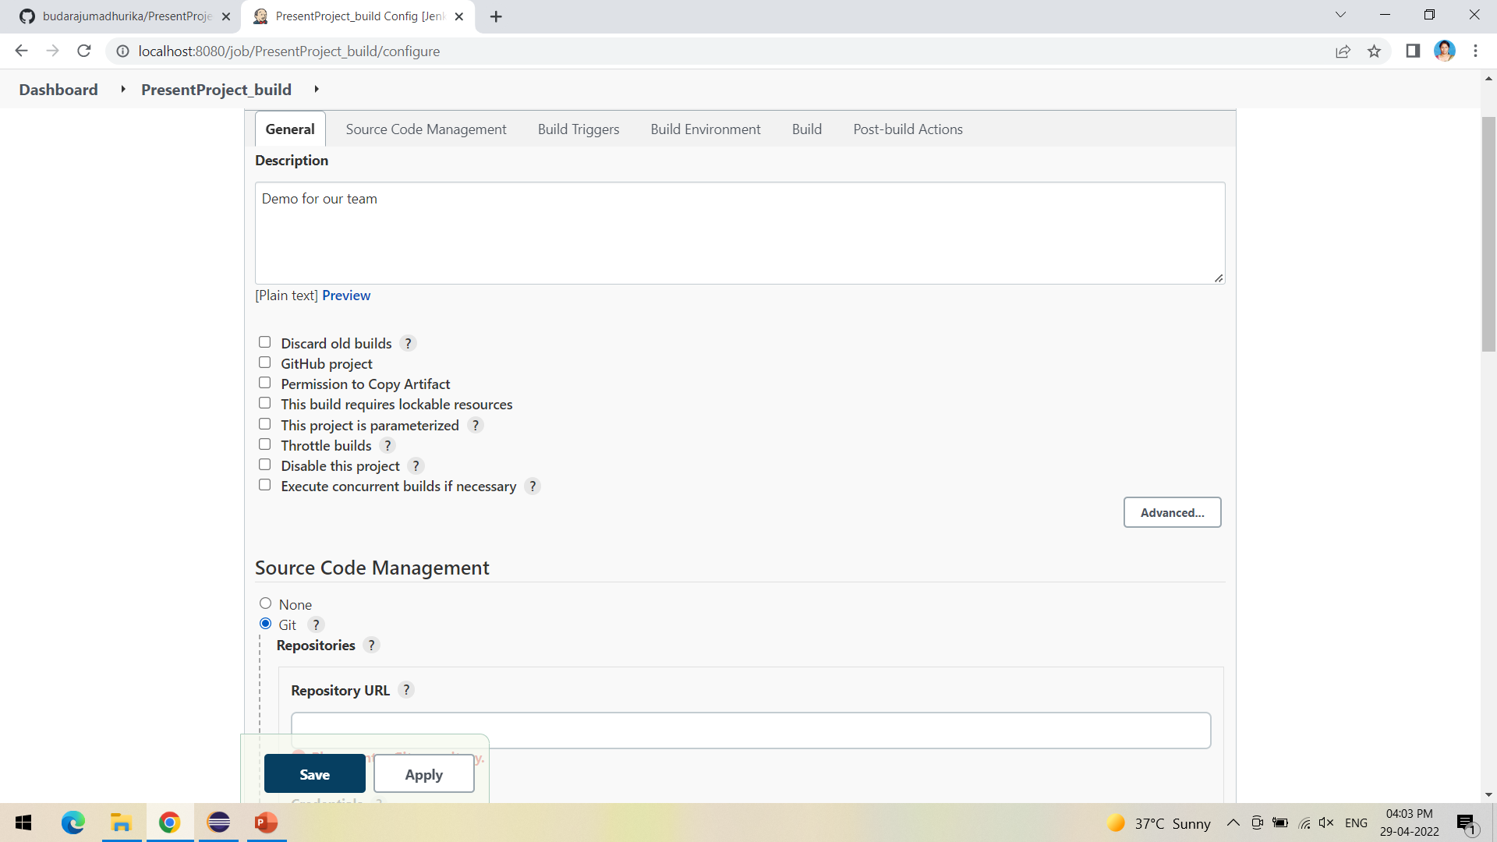
The next step is to give the Git repository URL of the project to be built

Slide 36
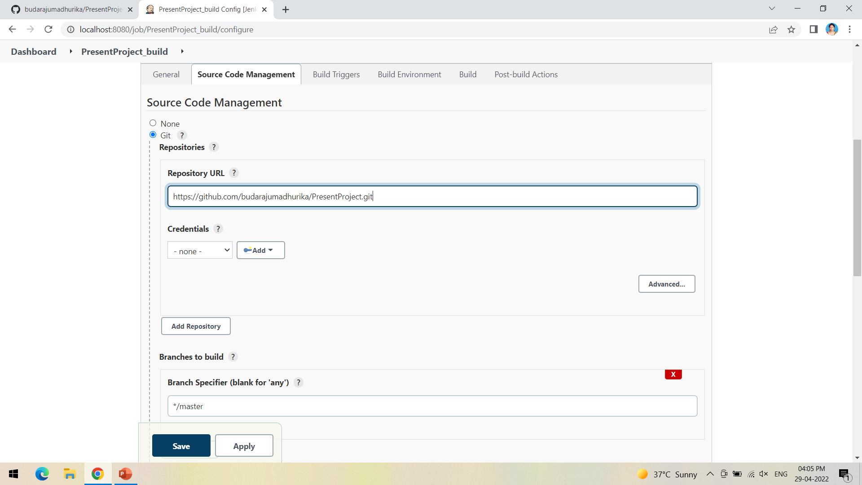
After adding the repository URL, Specify the Branch as either Master/Main as it is in the GitHub

Slide 37
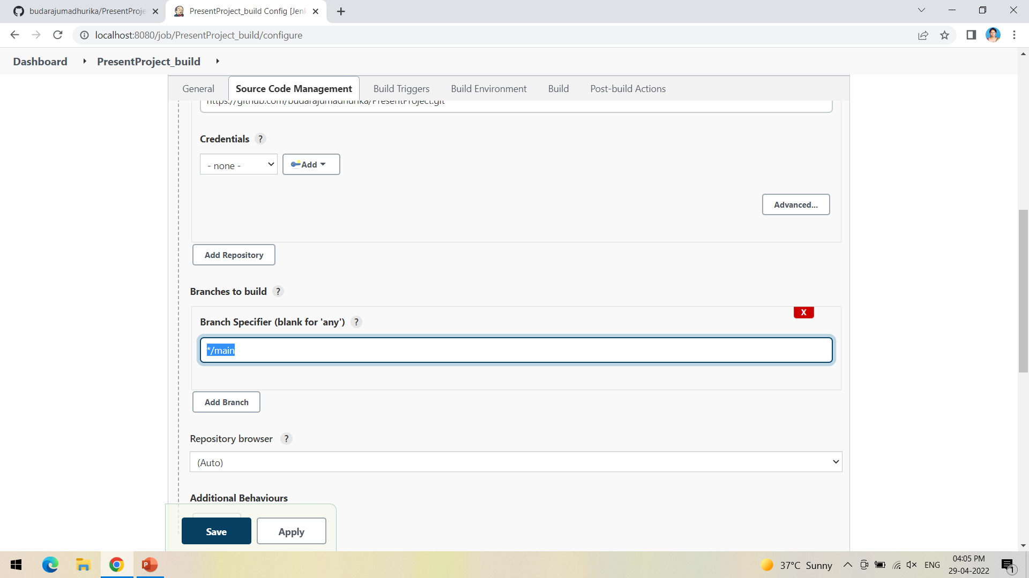
My project is in main branch so I have mentioned main

Slide 38
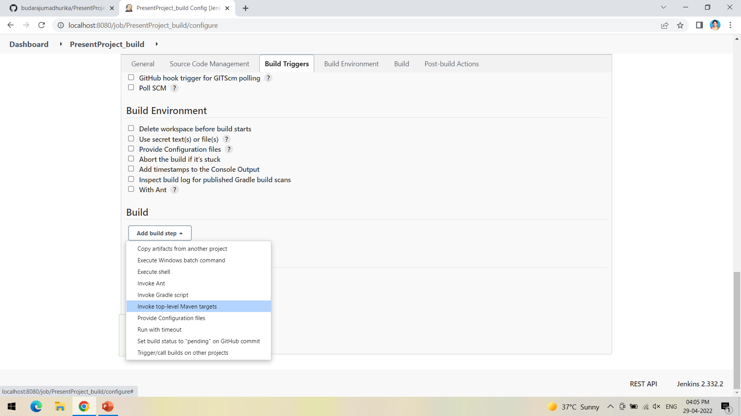
Now in Build, Invoke top-level Maven targets

Slide 39
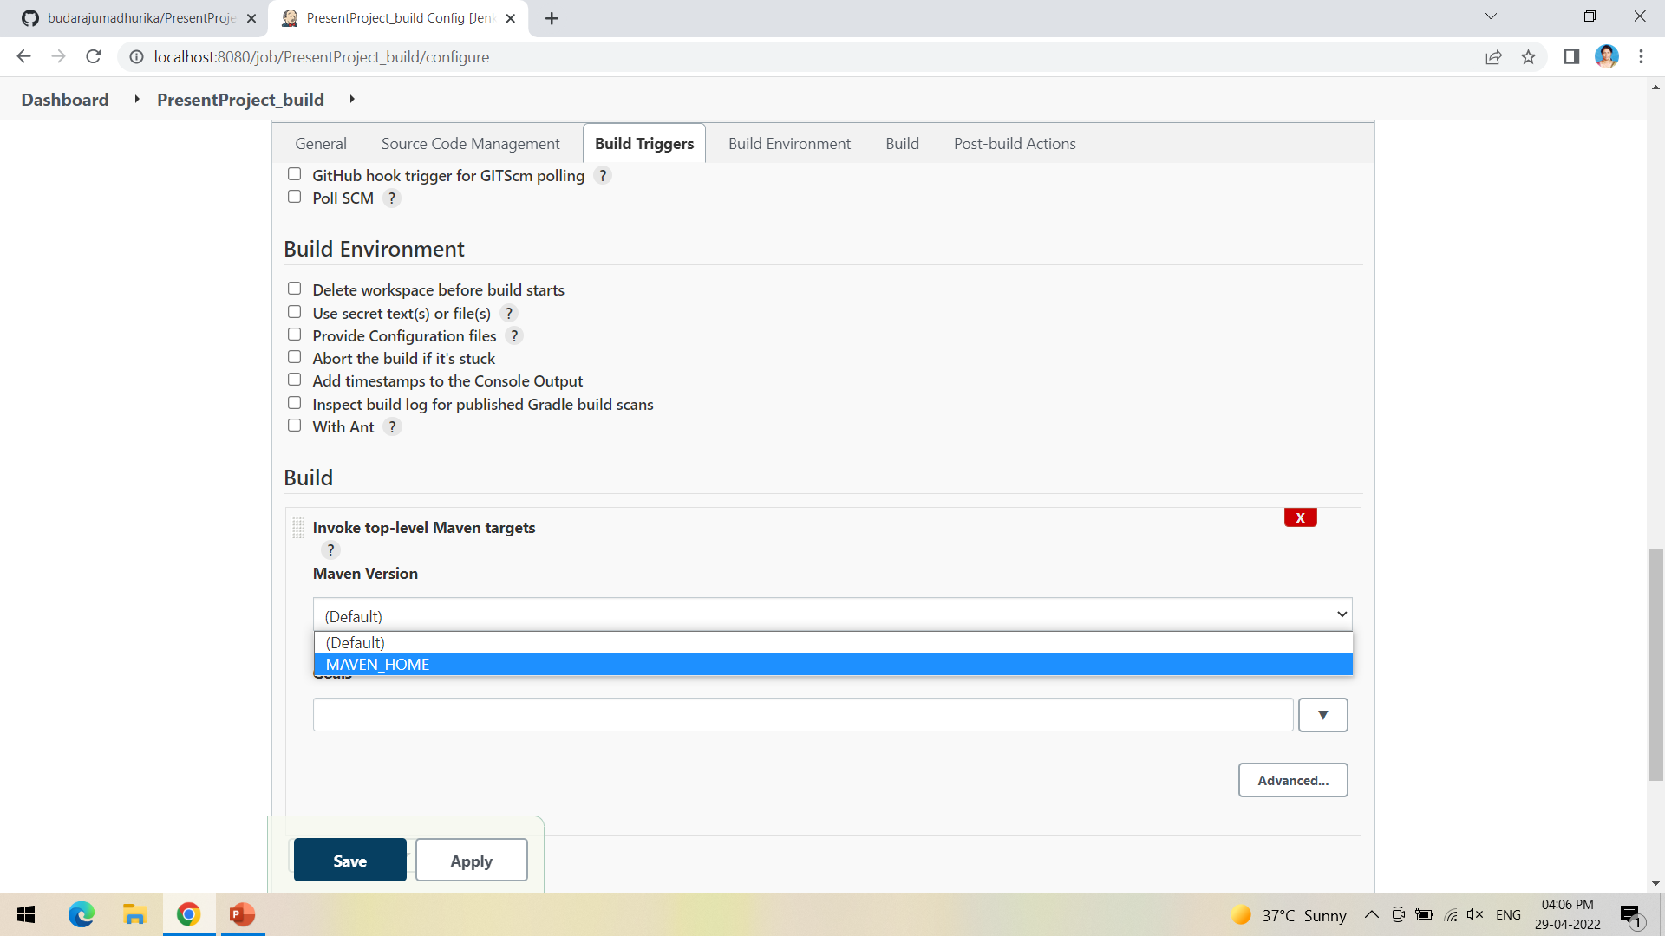
Select the Maven path which is already set in the global credentials in Manage Jenkins

Slide 40
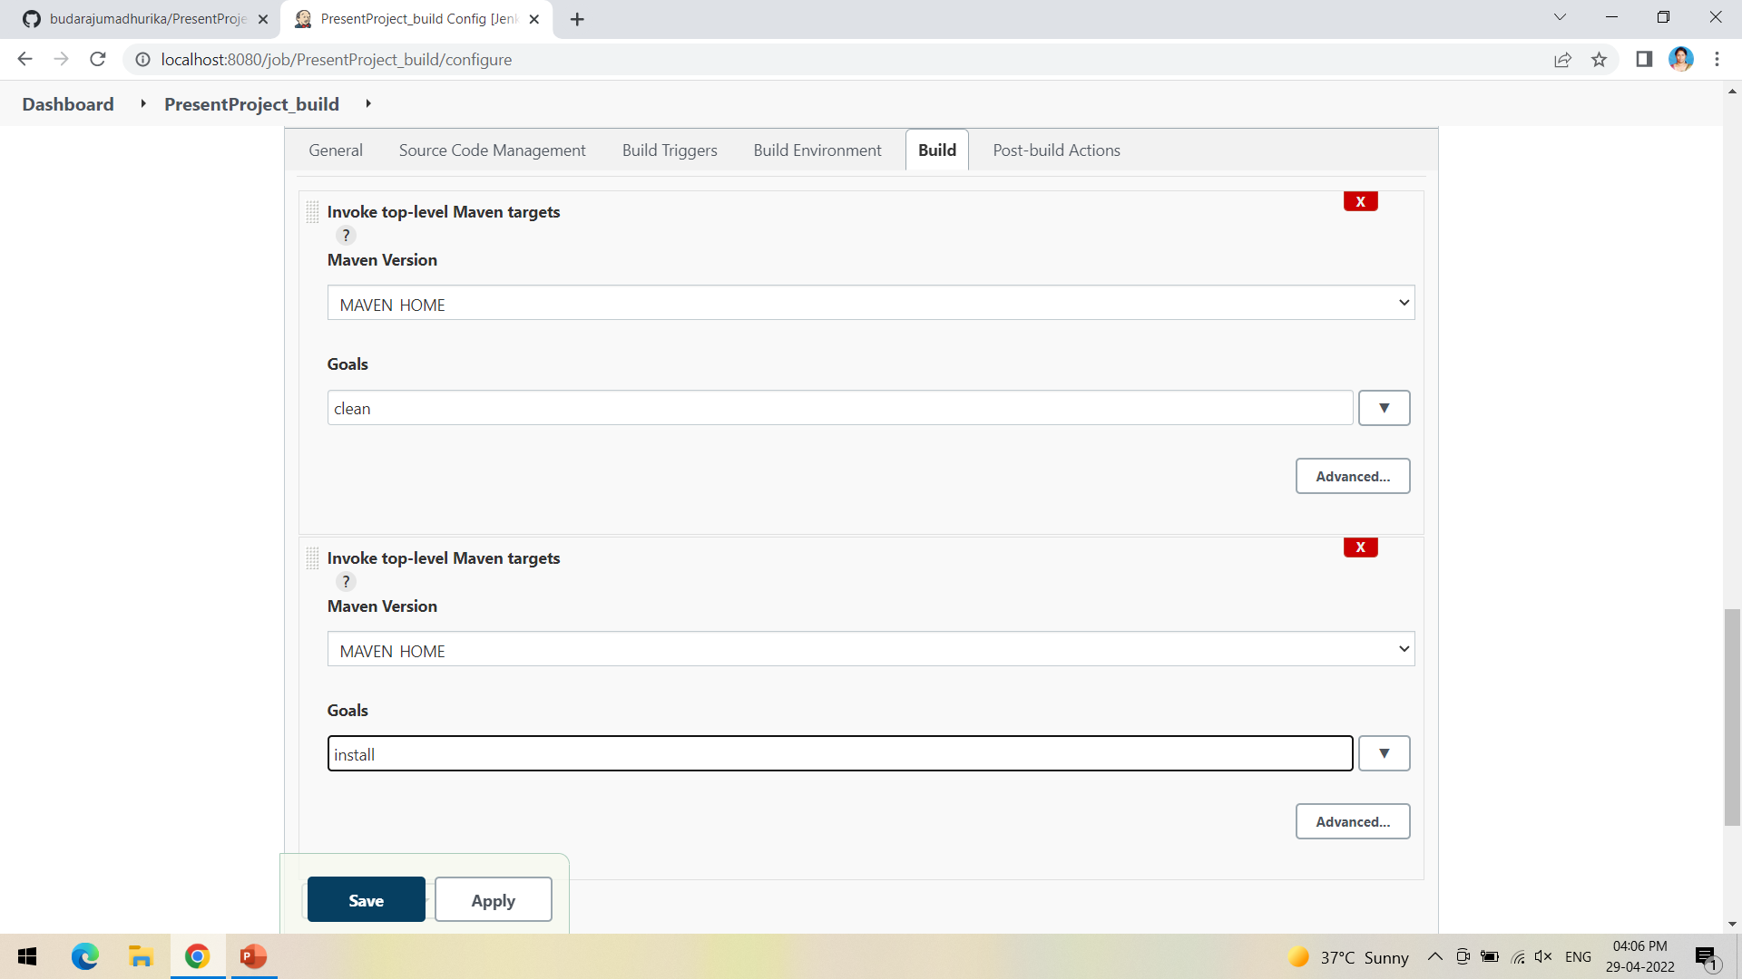
Follow the same goals as done in eclipse starting with clean and install

Slide 41
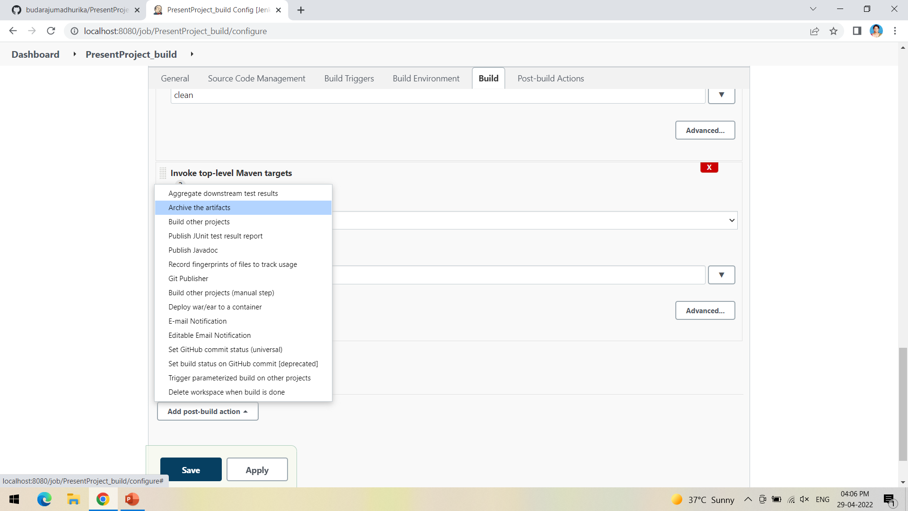
Now in post build actions-> select Archive the artifacts, to send the output of build project to the testing team

Slide 42
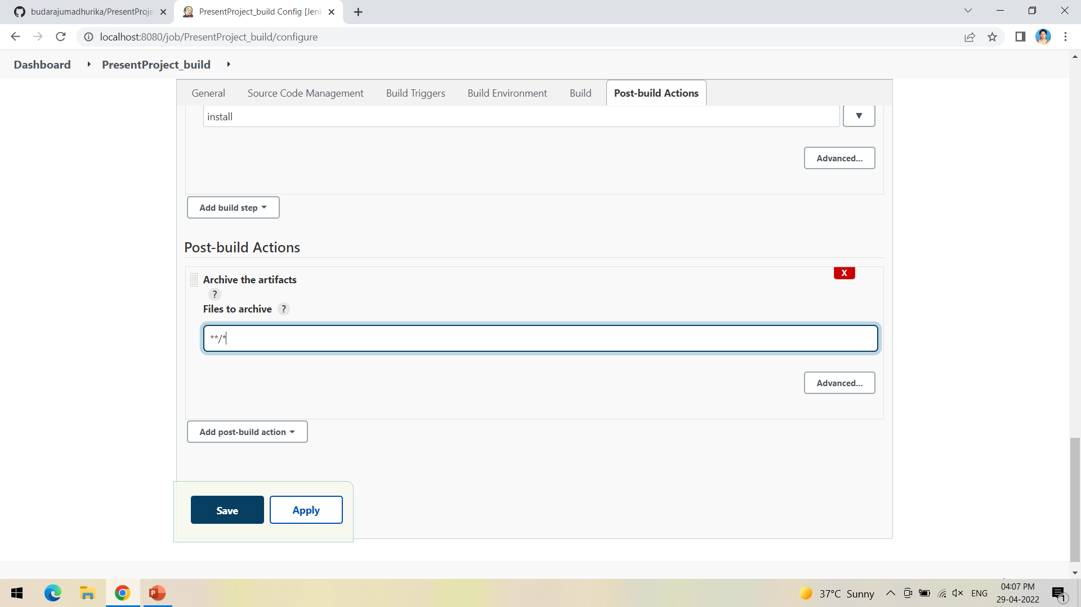
If we want to archive all the artifacts type **/* as shown

Slide 43
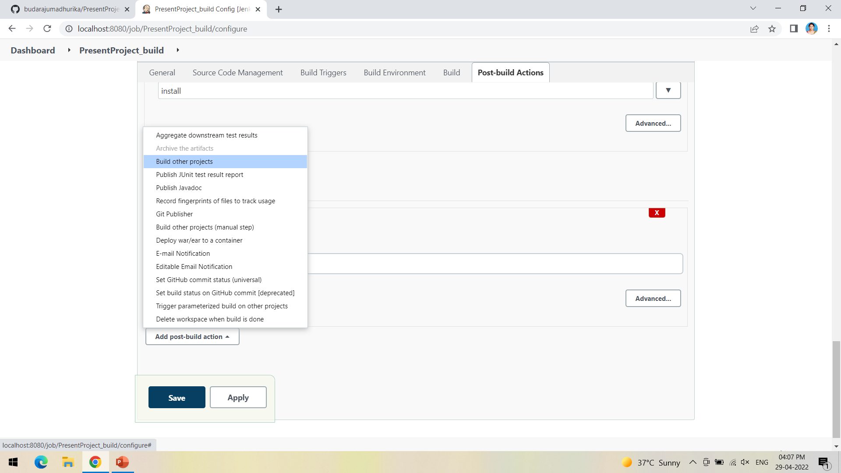
Now the next step is to build other projects, where we will create a test project which will be triggered by the build project

Slide 44
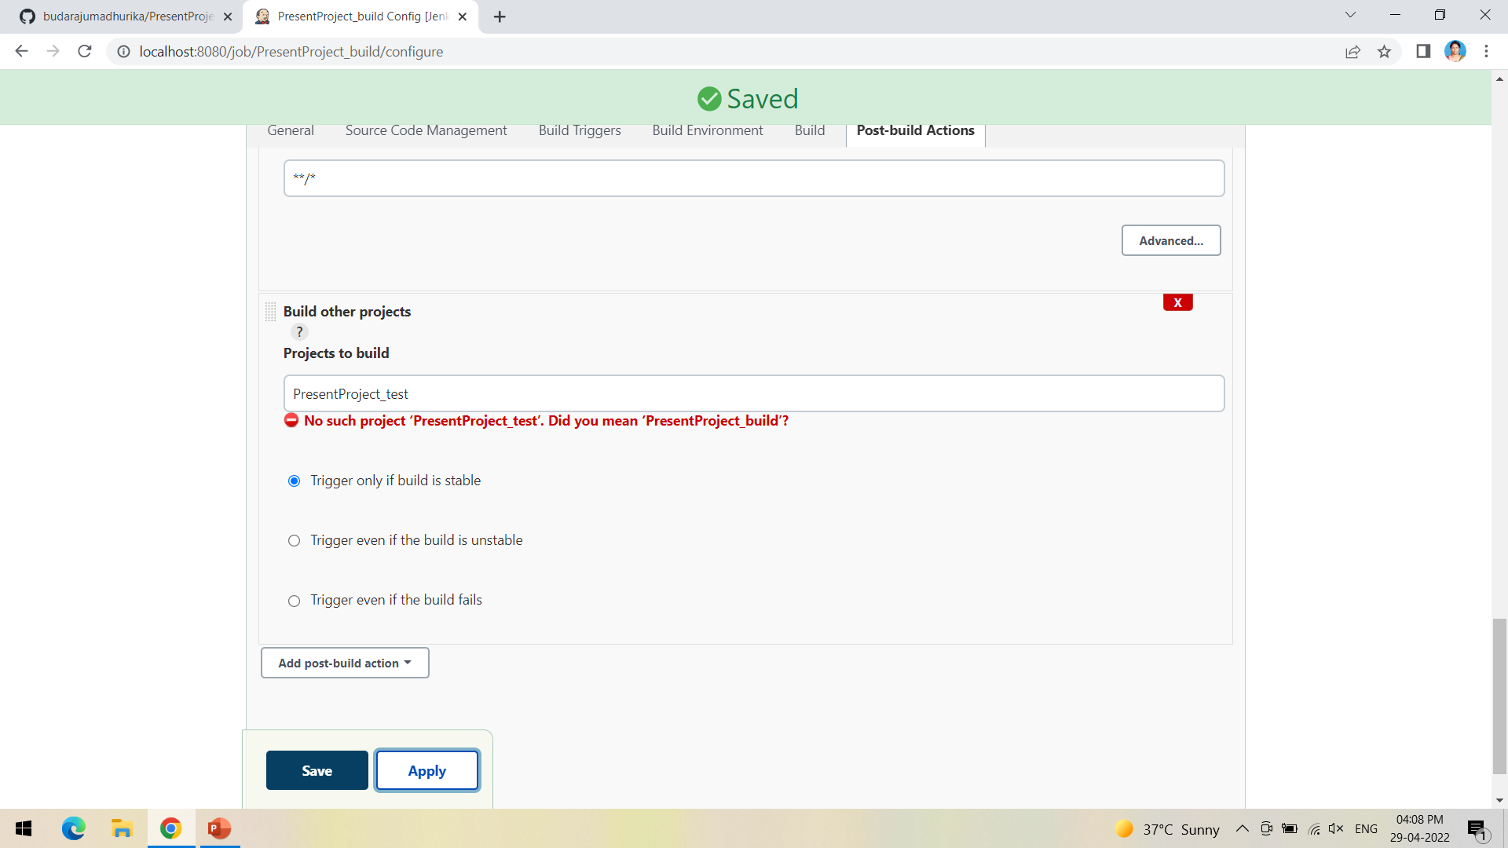
Ignore the red warning, as we have not yet created the test project

Slide 45
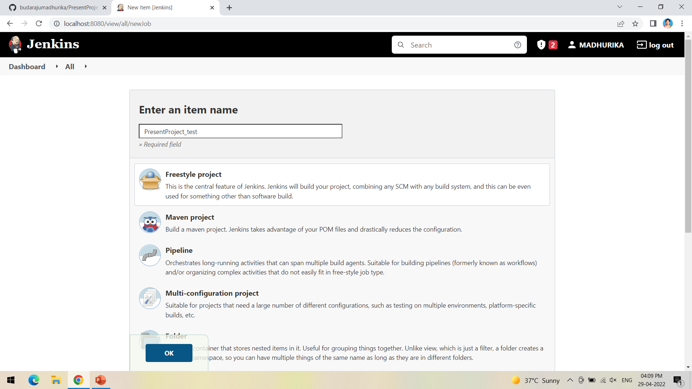
Create a new freestyle project test as shown and click ok

Slide 46
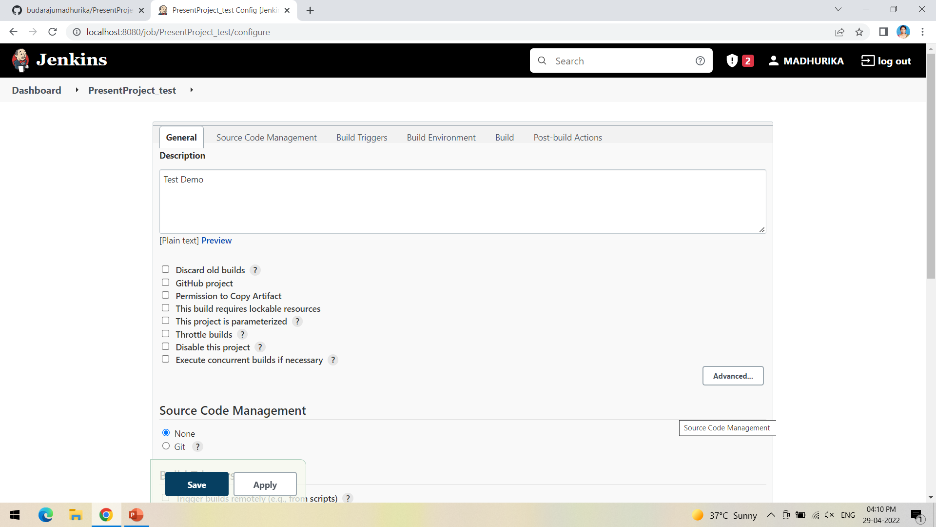
This time we need not mention the git repository so select None

Slide 47
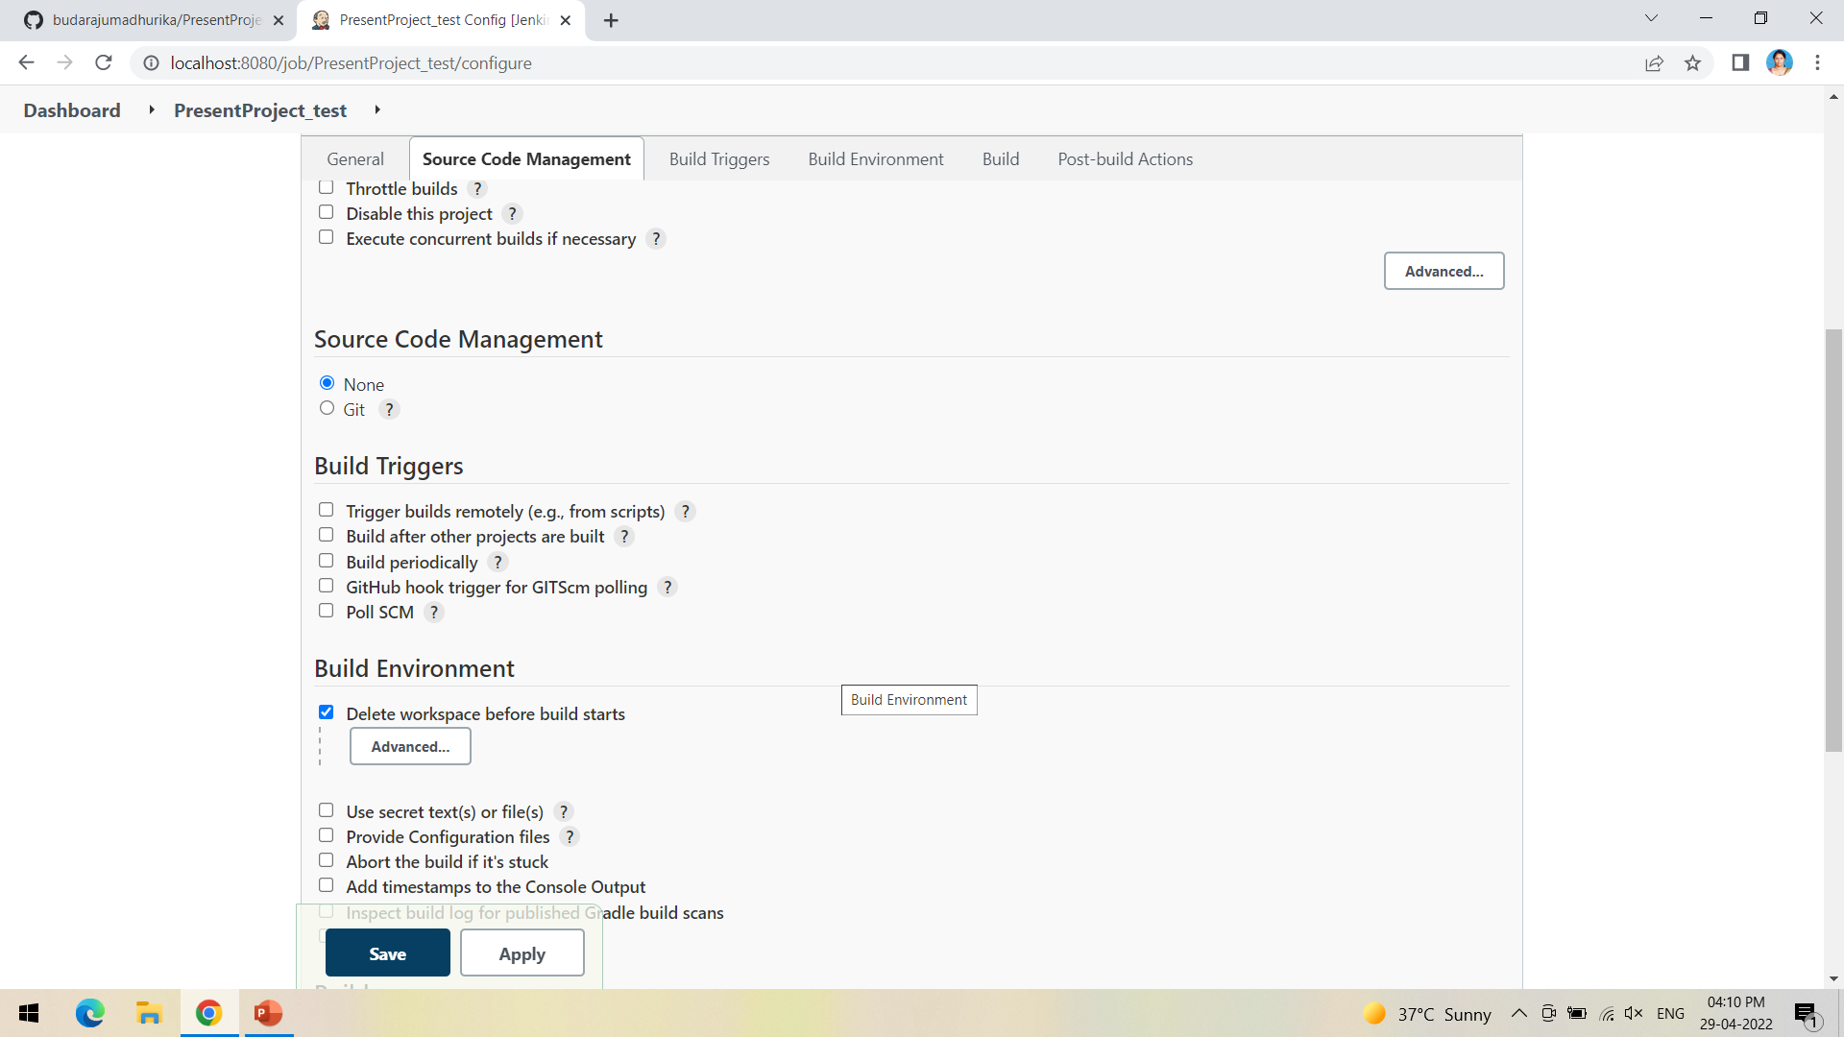
In Build environment check the box as shown below, this is to discard old builds

Slide 48
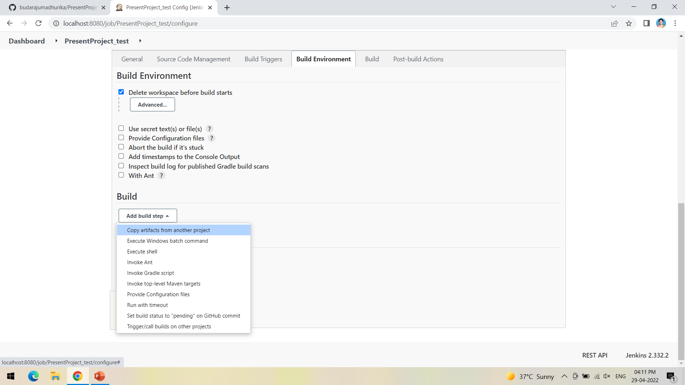
To forward the artifacts of the previous project to the current test project, select copy the artifacts from another project in Build as shown

Slide 49
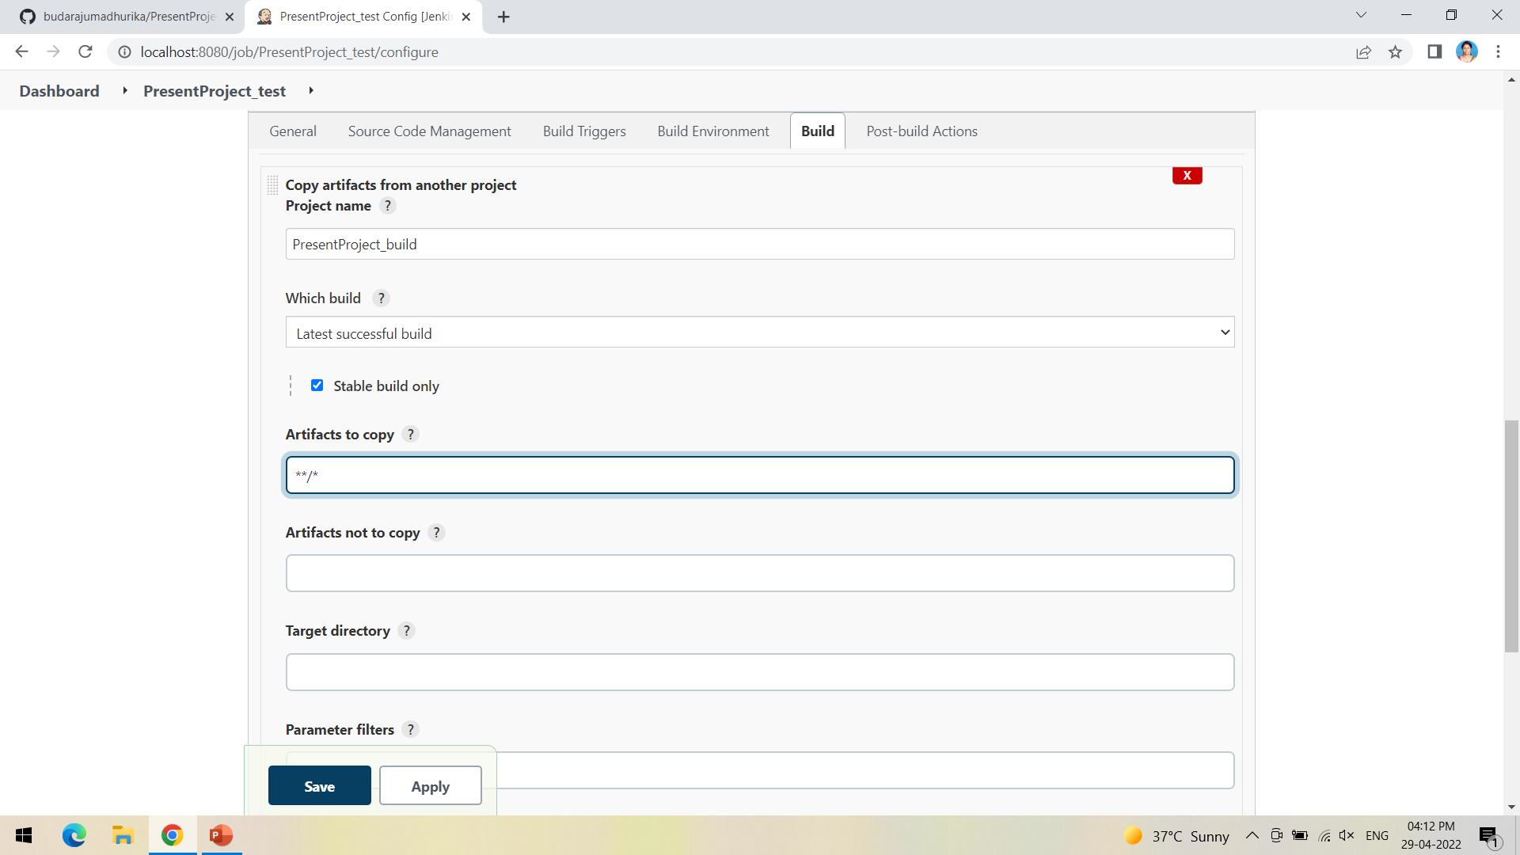
Give the name of the project from which we want to copy the artifacts and check the box ->stable build only->to copy all the artifacts type **/*

Slide 50
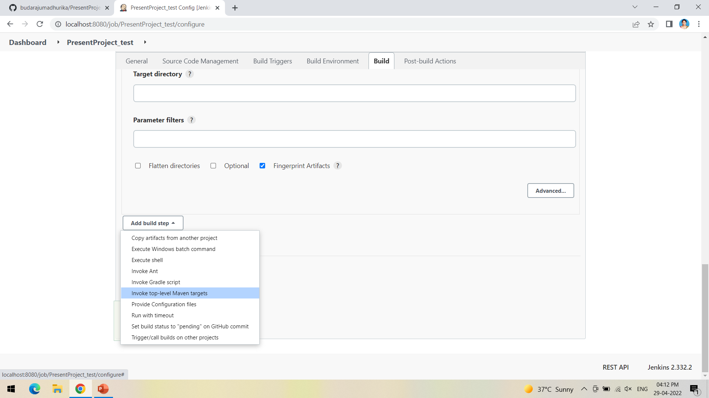
Now select Invoke top-level Maven targets in build

Slide 51
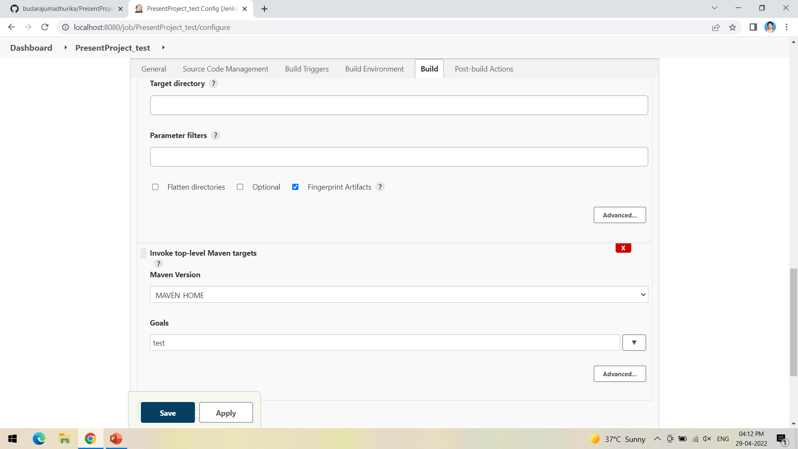
This time give the goal as test after selecting the Maven version

Slide 52

In post-build actions->select Archive the artifacts

Slide 53

To save all the artifacts->type **/* and Apply->Save

Slide 54

Create a pipeline by clicking on + symbol in the dashboard ->a pipeline is a collection of events or jobs which are interlinked with one another in a sequence

Slide 55

Give a name to the pipeline->select Build Pipeline View->create

Slide 56

Select the first project to trigger the execution->build project

Slide 57

Apply->Ok

Slide 58

Click on Run -> click on the small black box to open the console to check if the build is success

Slide 59

We can see that the build is success and the test project is also automatically triggered

Slide 60

The pipeline is successful if it is in green color as shown ->check the console of the test project

Slide 61

The test project is successful and all the artifacts are archived successfully

